Slide 1
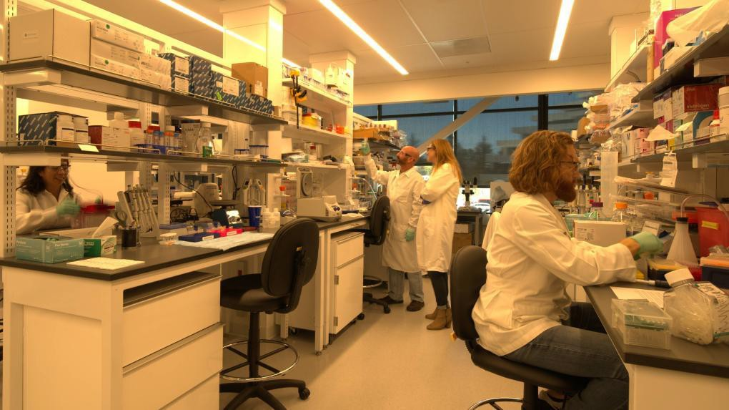



New Resident Onboarding
Pegasus Park
www.biolabs.io

Slide 2

Onboarding Agenda
About BioLabs and our Staff
Benefits and Perks
Virtual Platforms
Capital Connections
Exclusive Memberships
Centralized and Group Purchasing
Site Policies and Best Practices
Environmental Health & Safety (EHS)
Facility Overview and Parking
www.biolabs.io © 2023 All rights reserved
2

Slide 3


WHO ARE WE?
BioLabs is an incubator space for biotech startups. We provide the office & lab space, equipment, and resources for companies. You can focus on science and we will take care of the rest!
www.biolabs.io

Slide 4

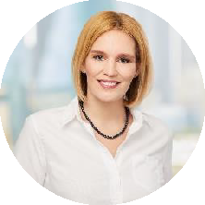
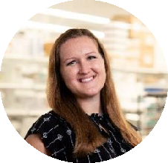
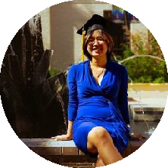
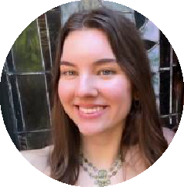
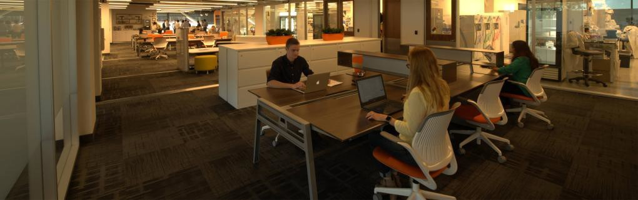

Meet our Staff
Gabby Everett
Site Director
Alyssa Dubrow
Associate Lab Manager
Texas A&M
B.S. in Biochemistry
Camille Shuey
Lab Operations Associate
UT Arlington
B.S. in Biomedical Engineering
Kathryn Sheaffer
Lab Operations Associate
Texas A&M
B.S. in Biology
Texas A&M PhD in Biochemistry

Slide 5






Exclusive Member Benefits
Access
Office Needs
Laboratory Needs
Capital Connections
Exclusive Memberships
Exclusive member events such as happy hours, seminars, lunch & learns, pitch events, and conversations that go on tangents
High-speed internet
11 conference rooms
3 printer and copy
centers
Café essentials
24/7 laboratory access
Shared equipment and cold storage
Select consumables provided
EH&S support: safety training, PPE, waste management
Access to leading industry partners through our sponsors and network
Company receives:
1 year of membership to BioNTX
Hidden Gym membership
1
2
3
4
5
www.biolabs.io © 2023 All rights reserved

Slide 6



Capital Connections
If you would like to personally reach out to our fabulous sponsors, send cshuey@biolabs.io an email and she can provide their contact information.
1
Founding Partner
2
Platinum Sponsor
3
Gold Sponsor
4
General Sponsor
www.biolabs.io © 2023 All rights reserved

Slide 7






UTSW Core Facilities
Connect with UTSW’s
Core Facility Director.
Go to the appropriate core facility
Contact any BioLabs Pegasus Park member to
put you in contact with UTSW.
You will receive
priority scheduling for facility use
www.biolabs.io © 2023 All rights reserved

Slide 8





Our Virtual Platforms
Package delivery- You will get an email notification that you have received a package. Please pick it up in the dock and remember to sign it out!
Conference room and equipment reservation- Conveniently book conference rooms and equipment through the Coworks app on your phone
Equipment monitoring- We monitor the temperature of your cold
storage and incubators
BioLabs NTX website- Find all these links and more on our website! https://www.biolabspegasuspark.com/
Access Code: 3060
www.biolabs.io © 2023 All rights reserved

Slide 9
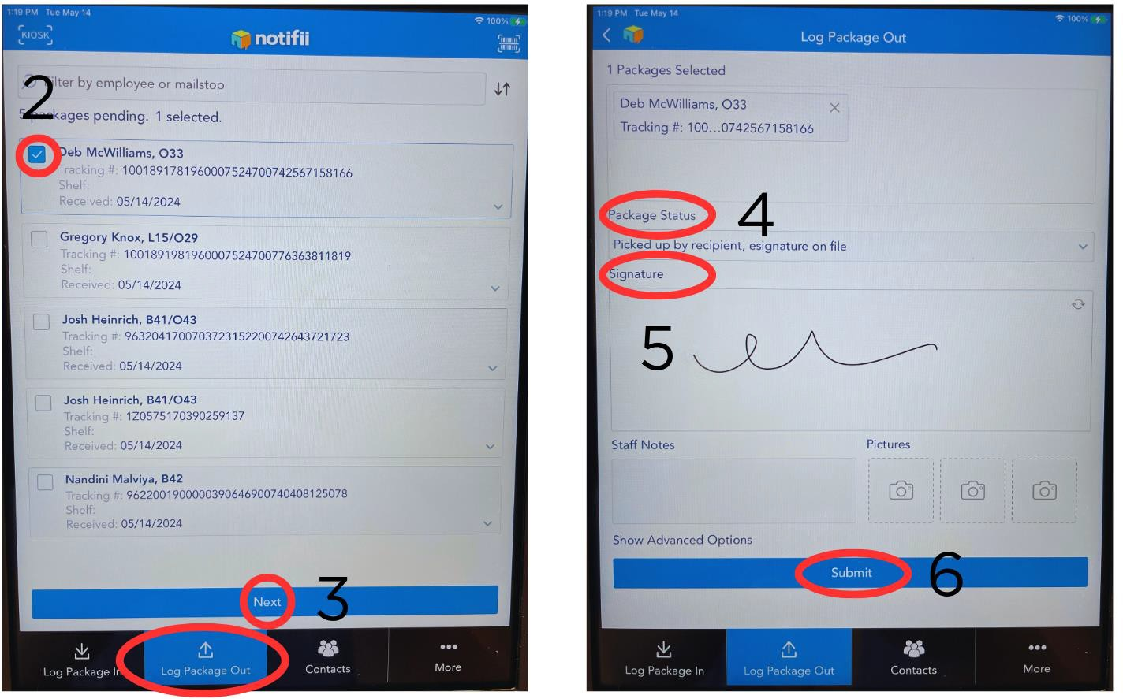
Notifii- Package Log Out System
1
www.biolabs.io © 2023 All rights reserved

Slide 10

Centralized Procurement System
Marketplace
Orders are processed through BioLabs procurement system, Marketplace.
80%
Simplifies the ordering process
Allows users to track orders
Special pricing available
Special Discounts
Average discounts of 35% off but have seen discounts up to 80% off at select vendors.
Once a package arrives on site, it will be logged in to the dock.
If you need to request a pick-up, it can be done through Marketplace.
Dock address: 3033 Irving Blvd. Dallas, TX 75247
Questions?
marketplace@biolabs.io
www.biolabs.io © 2023 All rights reserved

Slide 11
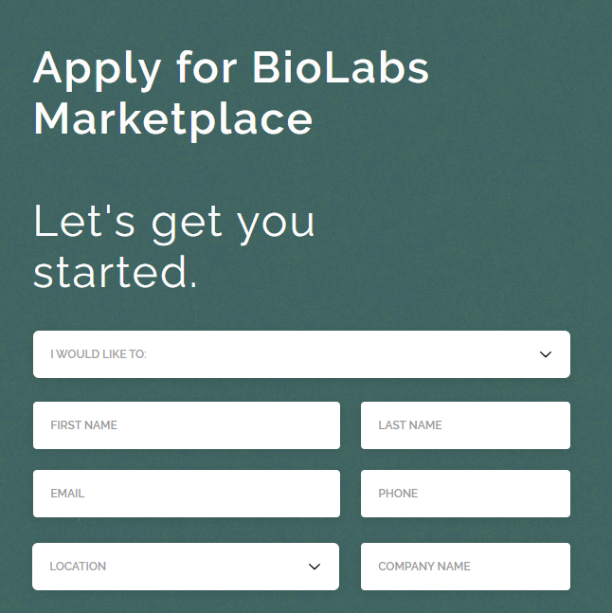
How to Sign Up for Marketplace
Navigate to the Marketplace tab on our website: HOME | BioLabs Pegasus Park
  Access code: 3060
Click on New User from the drop-down menu.
From the I Would Like To: menu, select Add a person to my company.
  If you are a new resident company, select Add my company to Marketplace.
Fill out your name, your email, phone number, and company name.
For the location, select BioLabs at Pegasus Park.
Hit Submit.
Marketplace will email you with more steps to set up your account. You may also attend a Marketplace training session led by the Marketplace team that will teach you about the user interface and Marketplace’s capabilities.

Slide 12

Supply Centers
A vending machine for science, so you can focus on what matters... results
Request products you'll always need on site
Same pricing as Marketplace
No shipping fees

Slide 13
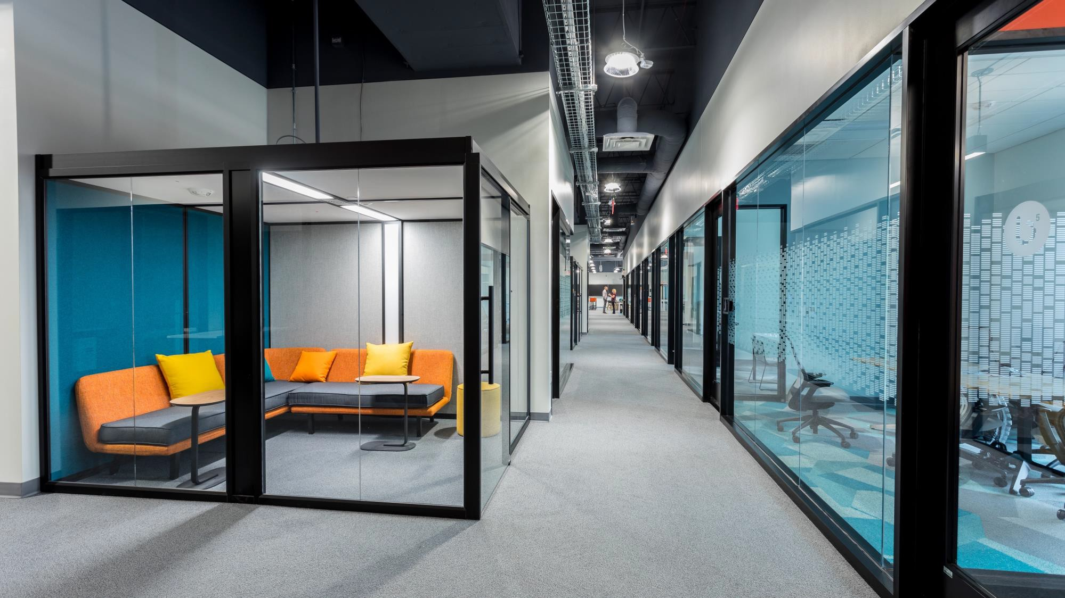


Conference Room
Policies
Book conference rooms through Coworks
Keep conversations low in shared spaces
DO NOT leave your personal items
unattended
DO NOT take items that are not yours
Clean up common areas after use (desks,
tabletops, couch, and chairs)
If you are eating, throw away your trash and put up any dishes

Slide 14
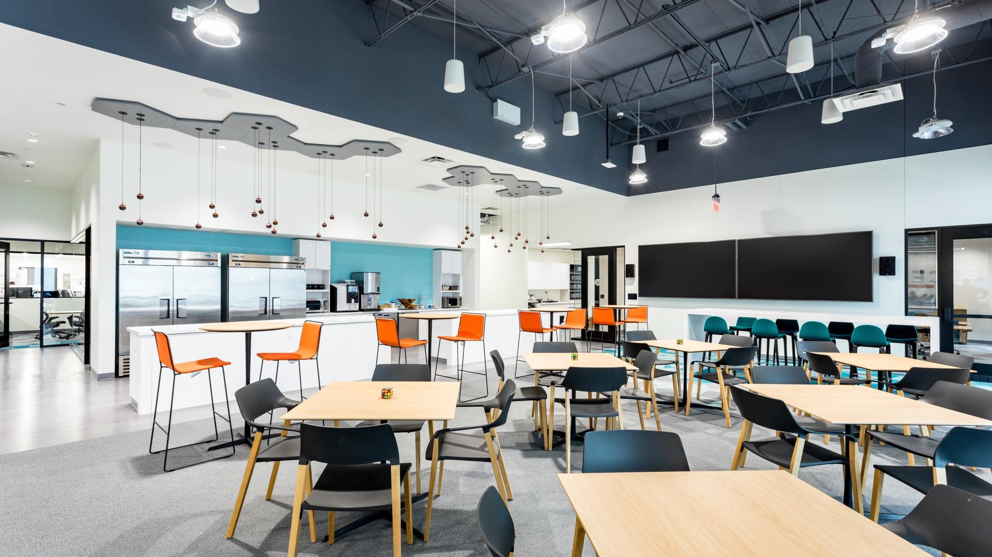
Cafe Policies
Clean up common areas after use (sinks, countertops, ice/water machine, coffee maker, microwave, and fridge)
DO NOT take items that are not yours
Fridge for communal items is on the
right, personal items is on the left
If you are eating, throw away your trash
and put dishes in the dishwasher
Be a good neighbor or whatever State
Farm says…

Slide 15





Recycling- General Facility
Cardboard- gray gondola in dock, flatten boxes
Styrofoam- blue gondola in dock
Paper- Shred-it can in front copy center (does NOT have to be sensitive material! All paper in here is shredded and recycled)
Batteries- front copy center
Cans- blue recycling bin in café
biolabs.io © 2023 All rights reserved.

Slide 16
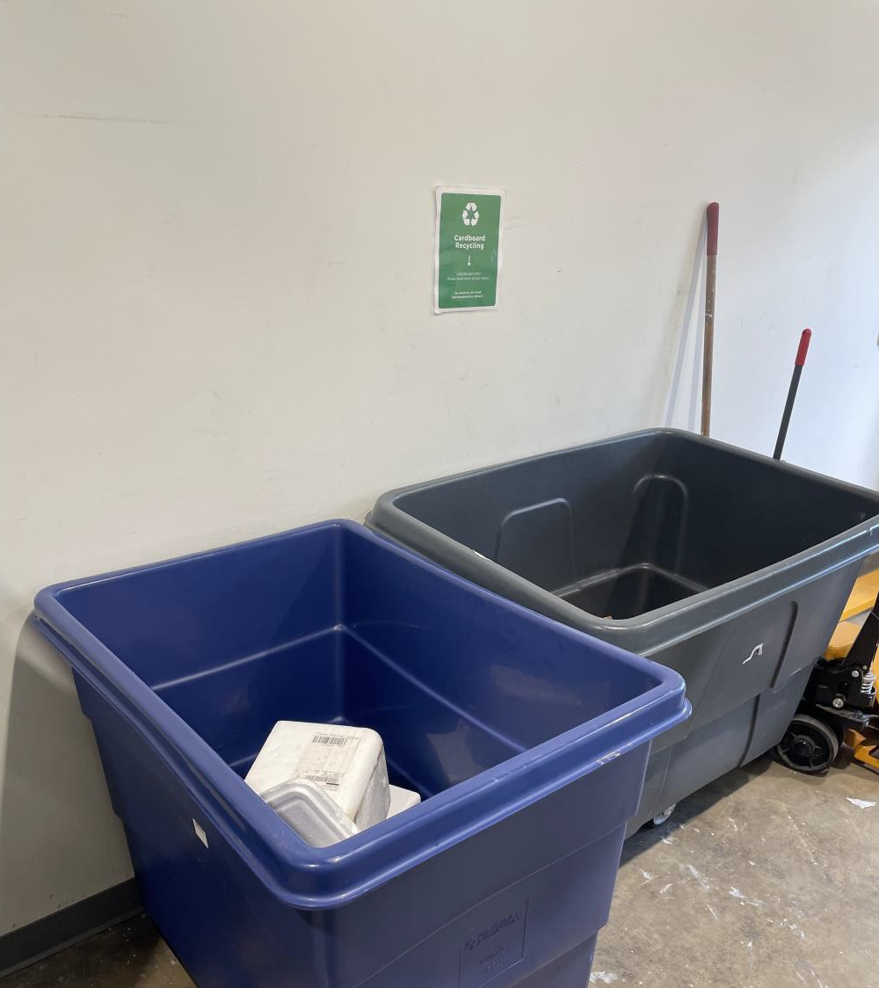
Dock
Cardboard Gondola:
  ONLY broken-down cardboard should be placed here
  DO NOT leave cardboard outside your labs or offices. They must be disposed of inside these carts
Styrofoam Gondola:
  ONLY empty styrofoam containers should be placed in the blue bin
  Nordic Ice packages can be thrown away in the trash
  Excess dry-ice needs to be placed inside dry-ice coolers found in the lab
biolabs.io © 2023 All rights reserved.

Slide 17
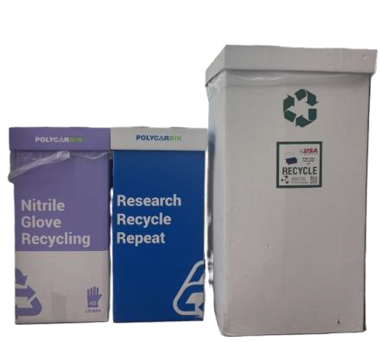
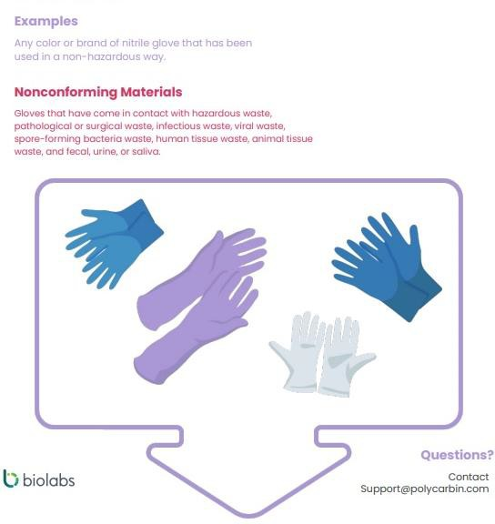
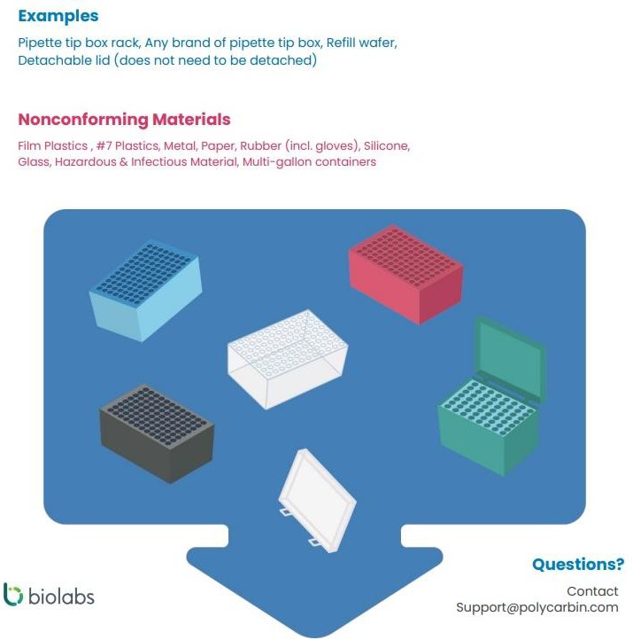
Recycling- Lab
biolabs.io © 2023 All rights reserved.

Slide 18
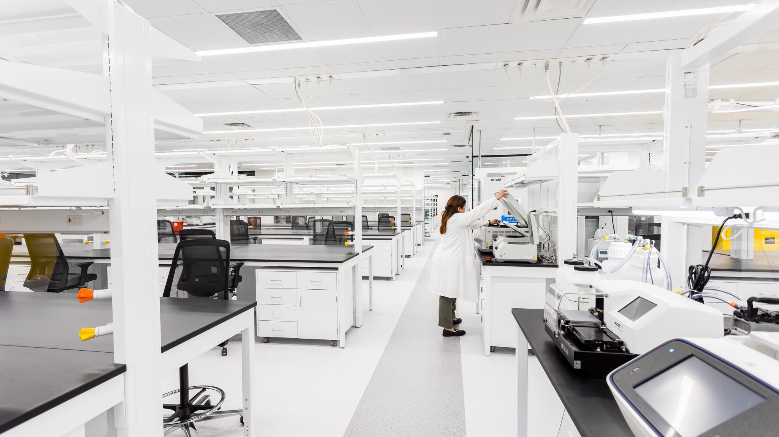
Lab Policies
You must wear a lab coat and glasses EVERY
TIME you step foot in lab (yes, that includes even if you are just walking through!)
Reserve equipment in advance through Coworks
Clean up common areas after use (sinks, equipment, ice spills)
Clean equipment before and after use
DO NOT eat, drink, or bring food into the lab
DO NOT bring hazardous material or PPE out of the lab.
DO NOT take items that are not yours (except
for provided consumables)

Slide 19

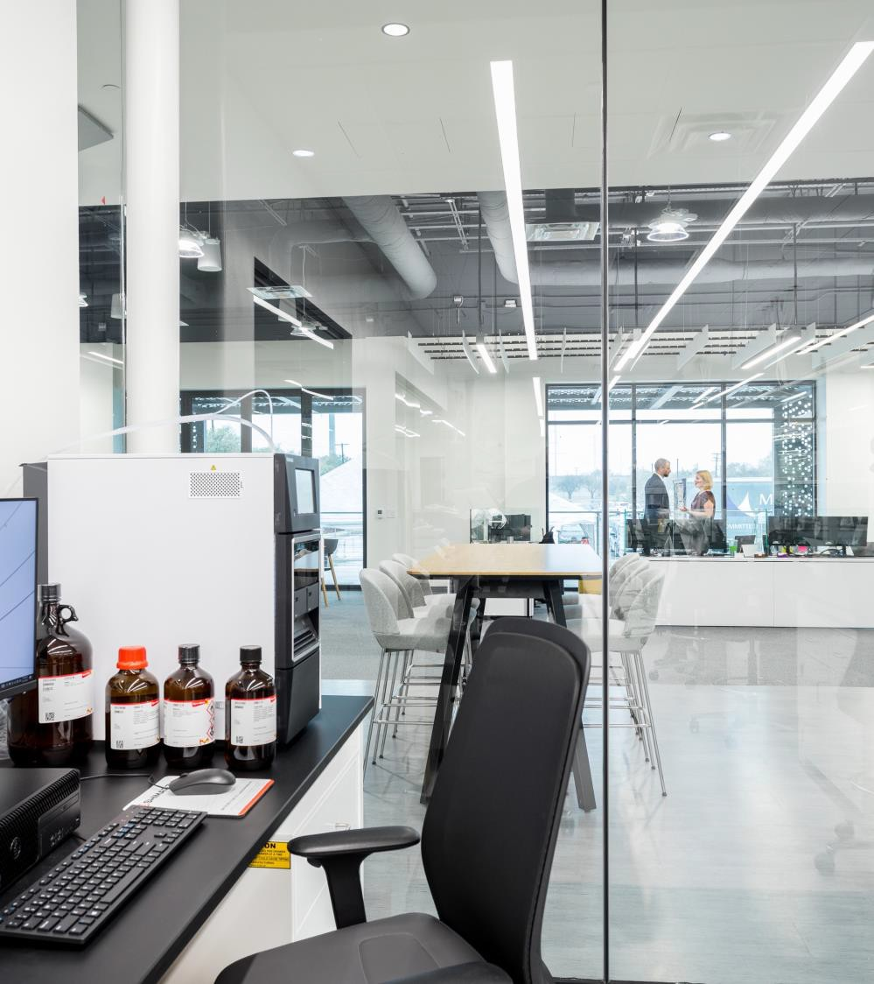



Environmental Health & Safety (EHS)
We are committed to safety!
ALL residents must complete online safety training to be familiar with EH&S policies and procedures (MediaLab)
Fill out all safety training and emergency contact form that is on our website
PPE is required (lab coat and glasses) AT ALL TIMES while in lab!
NO open toe shoes
NO shorts or short skirts
Notes:
As long as your foot is mostly covered you’re good

Slide 20
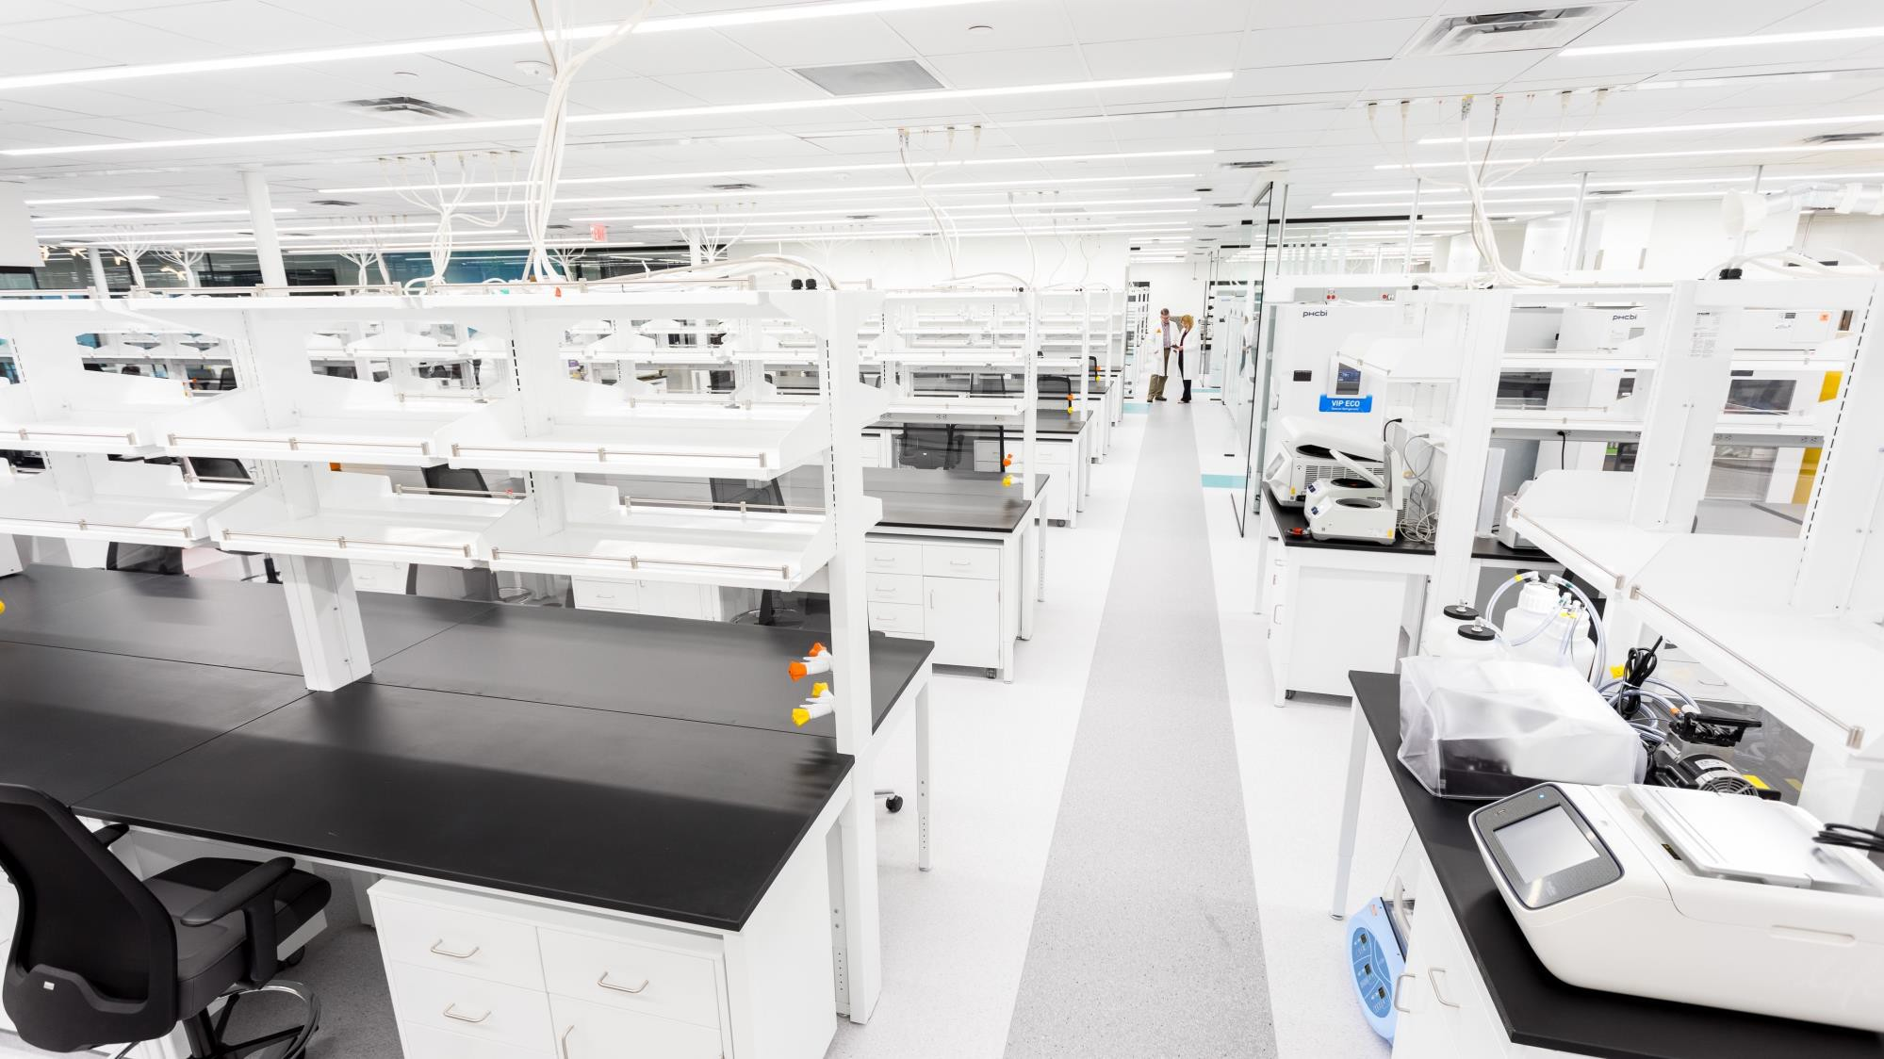

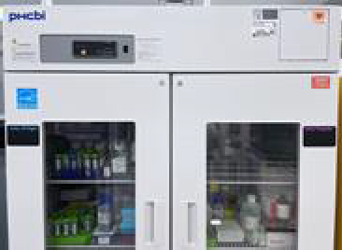
Storage
The following storage is allocated to each company:
  2 shelves in large 4C fridge
  1 shelf in –20 freezer
  1 shelf/row in –80 freezer
  1 shelf in small –20 freezer (1 freezer is split between
2 companies)
  1 shelf in small 4C fridge (1 fridge is split between 2 companies)
  Shelving above bench
  1 metal shelf in lab or storage room

Slide 21

Data Removal from Equipment
BioLabs removes data from equipment during last week of every month
  Protocols remain on instrument
biolabs.io © 2023 All rights reserved.

Slide 22
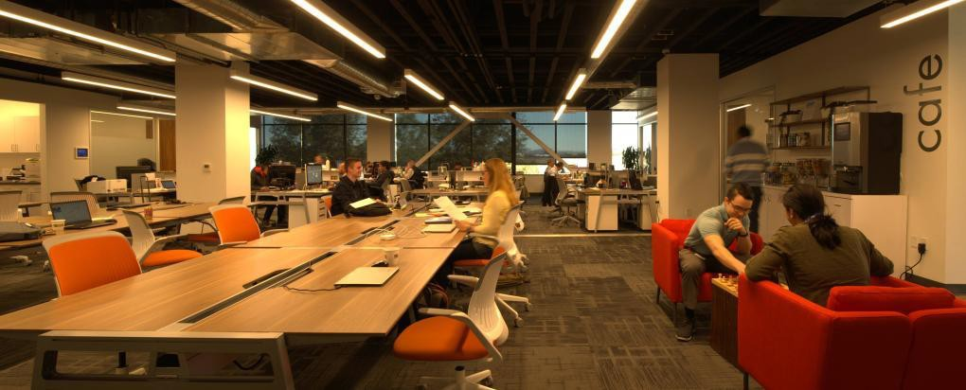


Types of
Waste
Non- Hazardous Waste
Biohazardous
Waste
Chemical
Waste
If you have any uncertainties with chemical disposal,
please reach out to our BioLabs Pegasus Park staff
www.biolabs.io © 2023 All rights reserved

Slide 23
Nonhazardous Waste
Can go down drain or in trash
Bleached biohazards
Neutral buffers
Uncontaminated media
If you have any uncertainties with biohazardous waste, please reach out to our BioLabs Pegasus Park staff
www.biolabs.io © 2023 All rights reserved

Slide 24

Liquid and Solid Biohazard Waste
Liquid Biohazard Waste
Add bleach to create a 10% solution
Let sit for 30 minutes
Disinfected contents can be discarded down the sink. Flush with water.
Solid Biohazard Waste
Biohazard waste bins can be found in the TC rooms and around lab
In the event a waste bin is full, you may bring it into the autoclave room and replace
it with a new one. Place full bag in an autoclave bin on the floor or RedAway box.
Residents CANNOT autoclave biohazardous waste; staff will do this!
If you have any uncertainties with biohazardous waste, please reach out to our BioLabs Pegasus Park staff
www.biolabs.io © 2023 All rights reserved

Slide 25
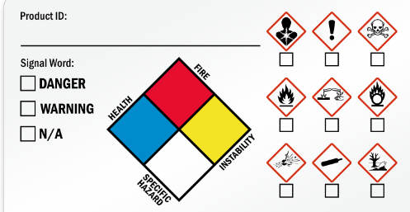
Hazardous Chemical Waste
Anything with "Warning", "Danger", etc on SDS
  MUST read SDS before ordering. Have plan for safe use, storage, and disposal
YOU MUST notify BioLabs staff of chemical waste being produced.
  Typically dispose of in container for liquid, ziploc for solids. Store in fumehood. Liquid and solid waste should be separated
Label waste bottles! Label “Your full name” waste "chemical name"
DO NOT combine chemicals!
DO NOT dispose of chemicals down drain!
  No EtOH down drain!
If you have any uncertainties with chemical disposal, please reach out to our BioLabs Pegasus Park staff
www.biolabs.io © 2023 All rights reserved

Slide 26
Hazardous Chemical Waste Cont.
DO NOT aspirate chemicals into TC aspirator bottles!
  These get bleached, so it can create toxic fumes
  No PFA!
DO NOT dispose of chemicals in autoclave bags!
  Bags get autoclaved, creates fumes or degrades autoclave
If waste contains both chemical and biohazardous waste, defaults to chemical
If you have any uncertainties with chemical disposal, please reach out to our BioLabs Pegasus Park staff
www.biolabs.io © 2023 All rights reserved

Slide 27
Safety Officers
BioNTX Colossal | Lauren A. Josh H.
PTC | Fani B.
EtiraRx | Russell H.
GenrAb | James H.
Ghost Fire | Nick R.
OncoNano Medicine | Jason M.
Reinvigoron | Kejin Z.
SingleCell Biotechnology | Karoliina S.
TraumaCare.AI | Vikas C.
CAGE Bio | Elaine C.
505bio | Don A.
CubicBio Jibe Therapeutics Telos Bio | Anna M. Jennifer P. Enzo T.
Each company has been appointed a safety officer.
Their roles will be to inform and enforce EHS regulations within their company
They will attend monthly meetings on safety updates then relay info to their company
biolabs.io © 2023 All rights reserved.

Slide 28

Site-wide SDS Repository
All on-site chemical SDS's can be found here: Site wide SDS pages Contact company safety officer for company-specific SDS's
biolabs.io © 2023 All rights reserved.

Slide 29
Chemical Inventory Sheets
ALL chemicals (whether hazardous or not) must be updated on an inventory sheet
Google docs/sheets
Inventory sheet shared with BioLabs staff Updated as chemicals received and depleted MUST INCLUDE:
CHEMICAL NAME
QUANTITY
MANUFACTURER
VENDOR
MANUFACTURER CAT #
DATE RECEIVED
CAS #
LOCATION (ex: fridge, freezer, bench, etc.)
biolabs.io © 2023 All rights reserved.

Slide 30
EHS Violation Policy
Tier 1
Tier 2
Tier 3
Most serious breaches of safety policies.
These violations pose an immediate and significant threat to the safety of individuals, property,
A serious safety hazard, regulatory violation and/or significant fire and life safety code violation.
Moderate breaches of safety policies that may not immediately pose significant risks but require corrective action.
or the environment.
biolabs.io © 2023 All rights reserved.

Slide 31
Examples
Tier 1:
Working in the lab under the influence of drugs or alcohol.
Willful disregard for safety procedures that directly endangers lives.
Utilizing prohibited materials on a BioLabs site (e.g., radioactive materials, BSL3).
Combining incompatible waste streams/chemicals
Tier 2:
Bringing or consuming food or drink in the lab.
Failure to label hazardous materials appropriately.
Working on hazardous work in the lab outside of normal business hours alone without prior approval and a buddy.
Tier 3:
Failure to wear proper PPE while in the lab.
Not closing hazardous waste bins after adding waste.
Touching a door with a gloved hand.
www.biolabs.io © 2023 All rights reserved

Slide 32
Tiered Responses
Tier 1
Tier 2
Tier 3
Immediately discuss with person and stop work.
Suspended privileges or termination from the BioLabs site pending an investigation.
One warning
Escalation to the persons supervisor
Corrective action plan (retraining, written work plan, suspended privileges, etc.)
Two warnings
Escalation to the persons supervisor
Corrective action plan (retraining, written work plan, suspended privileges, etc.)
www.biolabs.io © 2023 All rights reserved

Slide 33
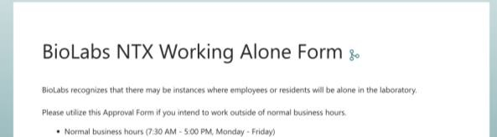
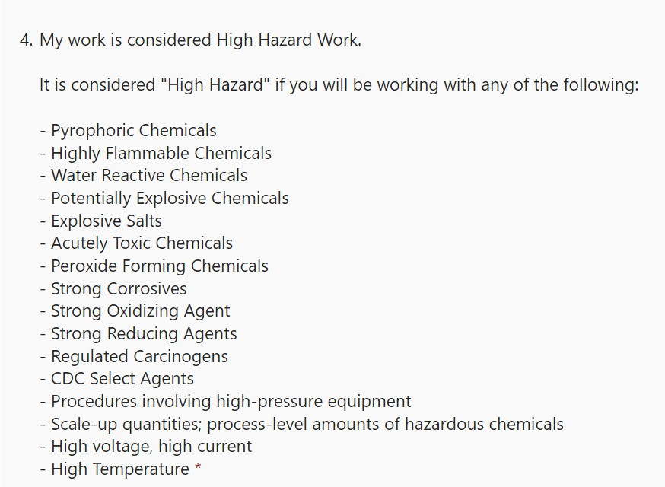
Working Alone Form
High risk work will be complete with a buddy
Both people must fill out the form
Work alone should be completed for each type
of work done
Example: TC work, viral work, bacterial
cultures, mini preps
Is your work considered high hazard work?
If you don’t know, come ask BioLabs staff
biolabs.io © 2023 All rights reserved.

Slide 34
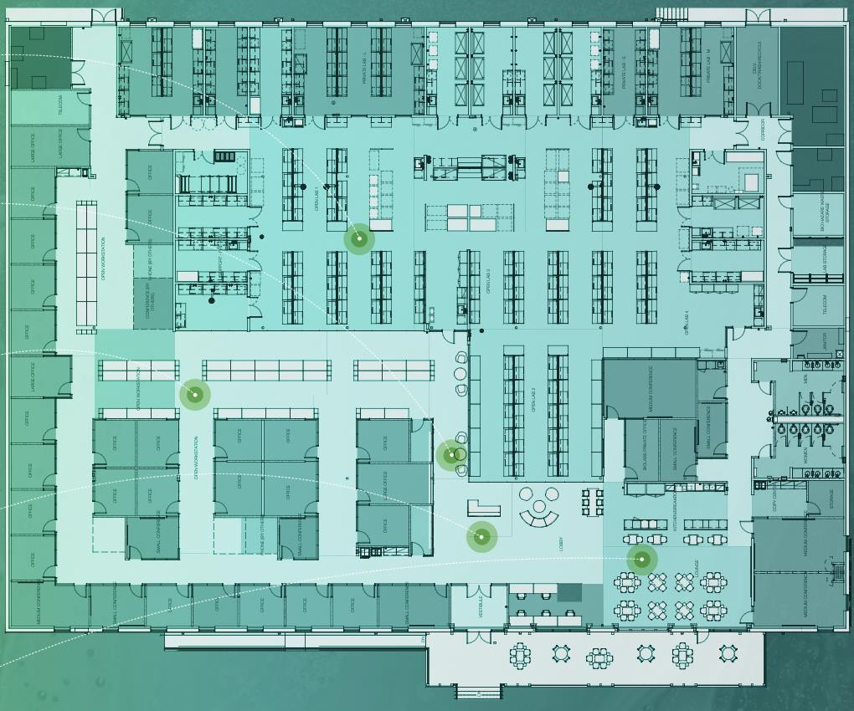
Facility Overview
During an emergency, do not panic! Make your way out of the nearest exit to muster points.
Eye wash stations are at every sink, and shower/eye wash stations can be found throughout the lab (yellow circles).
If you need additional assistance, let any BioLabs staff member know!
www.biolabs.io © 2023 All rights reserved
Notes:
Safety officers are responsible for headcount, text staff once everyone has been accounted for.

Slide 35
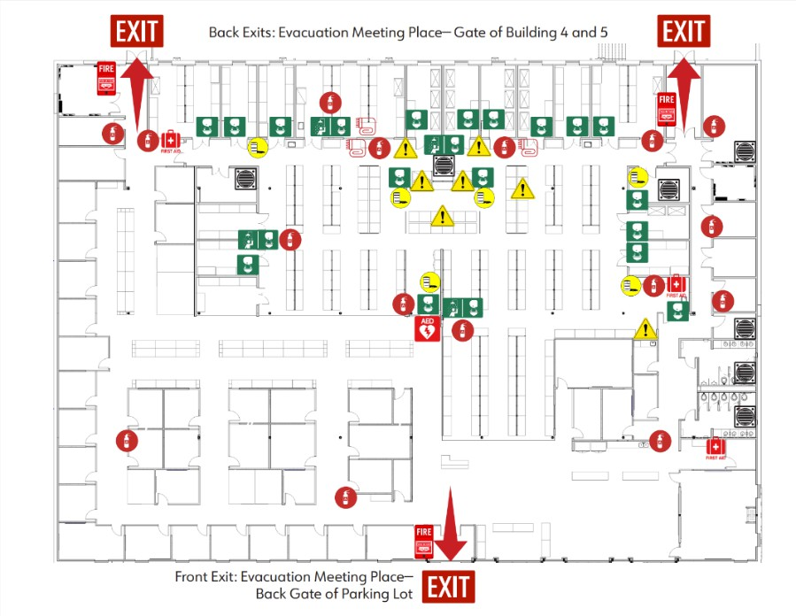
Safety Specs Locations
There are several safety maps posted across the site with locations for the following
Safety showers and eyewash stations
Evacuation exits
Fire extinguishers, blankets, & alarms
AED
Hazardous chemical storage
Spill kits
Drains
The maps will have a star that indicate where you are
biolabs.io © 2023 All rights reserved.

Slide 36
Access to the Campus
3000 Pegasus Park DriveDallas, TX 75247
Phone 214-785-0850
Application For Building Access Card
Please complete the following form for each person to receive an access card andreturn to lstermer@jsmall.com
Holiday or After Hours Access
  If you will need access to the campus after hours on the weekends or holidays, please fill out the application form to the right.
  Email the completed form to lstermer@jsmall.com and pegasussecurity@mail.iidon.net.
Date:
Employee Name: Phone Number:
Company: Suite:
Primary Car
License #:
Secondary Car
License #:
State: Make: Model: Color: |  | State: Make: Model: Color:
Year: |  | Year:
Office Use Only:
Access Card Number Date Issued New Replacement Cancel
The current building hours are 7:00 AM until 6:00 PM, Monday through Friday and 7:00AM until 1:00 PM on Saturday. If your card is lost or damaged, notify the management office immediately so that it can be removed from the system and a new one issued. The replacement fee is $15.00.
biolabs.io © 2023 All rights reserved.

Slide 37

Stranger Danger is REAL
Security starts with YOU!
  DON'T let people in you
don't know
  Blame BioLabs (because
we're mean)
Remember your badges
  Please
Security concerns?
  972-595-8493
biolabs.io © 2023 All rights reserved.

Slide 38

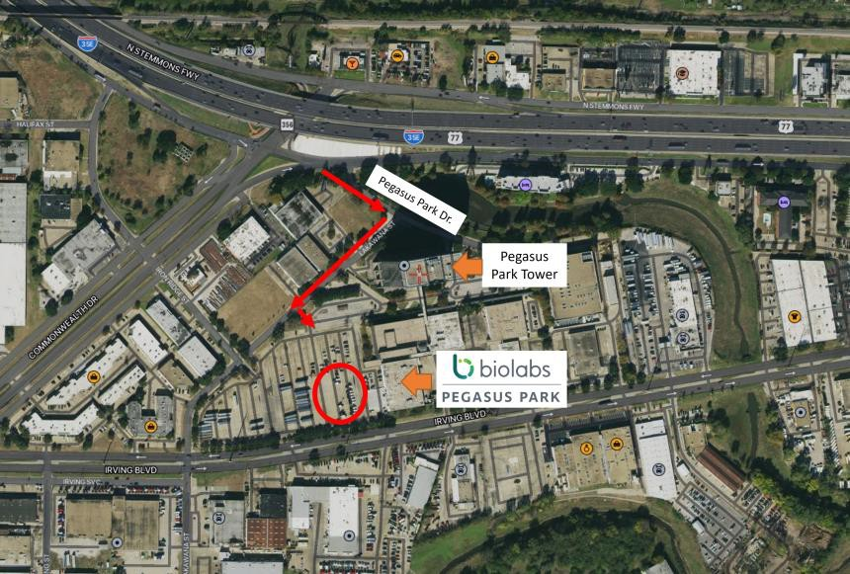
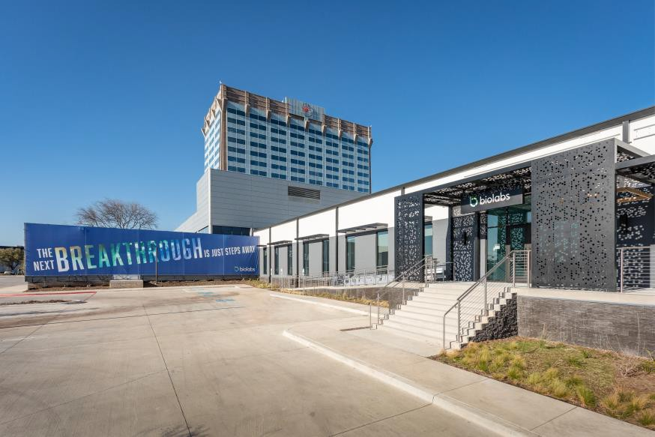
Parking Overview
Unless otherwise specified, all residents will have access to free parking at the front entrance of BioLabs Pegasus Park.
www.biolabs.io © 2023 All rights reserved

Slide 39

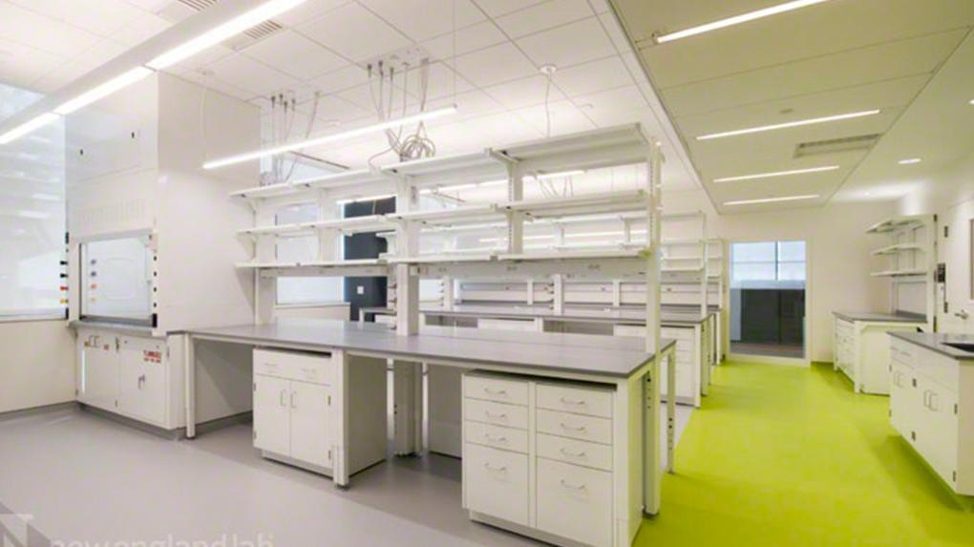



Thank You
3060 Pegasus Park Dr. Dallas, TX 75247
www.biolabs.io

