Slide 1
Non-Resident BioLabs Onboarding
Pegasus Park

Slide 2
Onboarding Agenda
About BioLabs and our Staff
Site Policies and Best Practices
Environmental Health & Safety (EHS)
Facility Overview
www.biolabs.io © 2023 All rights reserved

Slide 3
WHO ARE WE?
BioLabs is an incubator space for biotech startups. We provide the office & lab space, equipment, and resources for companies. You can focus on science and we will take care of the rest!

Slide 4
Meet our Staff
Gabby Everett
Alyssa Dubrow
Sydni Holmes
Camille Shuey
Site Director
Associate Lab Manager
Lab Operations Associate
Lab Operations Associate
Texas A&M
PhD in Biochemistry
Texas A&M
B.S. in Biochemistry
UT Dallas
B.S. in
Biology
UT Arlington
B.S. in Biomedical Engineering

Slide 5
Membership Policies
1 monthly membership = 1 person’s access to lab (& facility? Breakout rooms? Snacks?)
Membership cannot be shared/transferred between individuals- any other lab users on site will be charged membership
Contact BioLabs staff for conference room/breakout room booking rates
Must adhere to BioLabs EHS policies
Complete safety training before entering lab, wear designated PPE, comply with chemical safety
Email Alyssa & Sydni which equipment will be used
Equipment training NOT provided

Slide 6
Conference Room Policies
Booking rate-
Contact BioLabs staff AT LEAST 1 week prior to event date- cannot guarantee desired room will be open
Keep conversations low in shared spaces
DO NOT leave your personal items unattended
DO NOT take items that are not yours
Clean up common areas after use (desks, tabletops, couch, and chairs)
If you are eating, throw away your trash and put up any dishes

Slide 7
Cafe Policies
Clean up common areas after use (sinks, countertops, ice/water machine, coffee maker, microwave, and fridge)
DO NOT take items that are not yours
Fridge for communal items is on the right, personal items is on the left
If you are eating, throw away your trash and put dishes in the dishwasher
Be a good neighbor or whatever State Farm says…
Notes:
This is not a quiet zone.

Slide 8
Stranger Danger is REAL
Security starts with YOU!
DON'T let people in you don't know
Blame BioLabs (because we're mean)
Security concerns?
972-595-8493

Slide 9
Lab Policies
You must wear a lab coat and glasses EVERY TIME you step foot in lab (yes, that includes even if you are just walking through!)
Ensure lab coat has BioLabs triangle patch- DO NOT USE RESIDENTS’ INDIVIDUAL COATS!
Lab coats cannot be worn outside of lab
Reserve equipment in advance through Coworks
Clean up common areas after use (sinks, equipment, ice spills)
DO NOT eat, drink, or bring food into the lab
DO NOT bring hazardous material or PPE out of the lab.
DO NOT take items that are not yours

Slide 10
Environmental Health & Safety (EHS) We are committed to safety!
ALL residents must complete online safety training to be familiar with EH&S policies and procedures (MediaLab)
Fill out all safety training and emergency contact form that is on our website
PPE is required (lab coat and glasses) AT ALL TIMES while in lab!
NO open toe shoes
NO shorts or short skirts

Slide 11
Recycling- Lab

Slide 12
Data Removal from Equipment
BioLabs removes data from equipment during last week of every month
Protocols remain on instrument

Slide 13
Non-Hazardous
Waste
Types of Waste
Biohazardous Waste
Chemical Waste
If you have any uncertainties with chemical disposal, please reach out to our BioLabs Pegasus Park staff

Slide 14
Nonhazardous Waste
Can go down drain or in trash
Bleached biohazards
Neutral buffers
Uncontaminated media
If you have any uncertainties with biohazardous waste, please reach out to our BioLabs Pegasus Park staff

Slide 15
Liquid and Solid Biohazard Waste
Liquid Biohazard Waste
Add bleach to create a 10% solution
Let sit for 30 minutes
Disinfected contents can be discarded down the sink. Flush with water.
Solid Biohazard Waste
Biohazard waste bins can be found in the TC rooms and around lab
In the event a waste bin is full, you may bring it into the autoclave room and replace it with a new one. Place full bag in an autoclave bin on the floor or RedAway box.
Residents CANNOT autoclave biohazardous waste; staff will do this!
If you have any uncertainties with biohazardous waste, please reach out to our BioLabs Pegasus Park staff

Slide 16
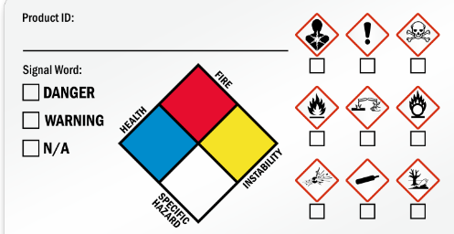
Hazardous Chemical Waste
Anything with "Warning", "Danger", etc on SDS
MUST read SDS before ordering. Have plan for safe use, storage, and disposal
YOU MUST notify BioLabs staff of chemical waste being produced.
Typically dispose of in container for liquid, ziploc for solids. Store in fumehood. Liquid and solid waste should be separated
Label waste bottles! Label “Your full name” waste "chemical name"
DO NOT combine chemicals!
DO NOT dispose of chemicals down drain!
No EtOH down drain!
If you have any uncertainties with chemical disposal, please reach out to our BioLabs Pegasus Park staff

Slide 17
Hazardous Chemical Waste Cont.
DO NOT aspirate chemicals into TC aspirator bottles!
These get bleached, so it can create toxic fumes
No PFA!
DO NOT dispose of chemicals in autoclave bags!
Bags get autoclaved, creates fumes or degrades autoclave
If waste contains both chemical and biohazardous waste, defaults to chemical
If you have any uncertainties with chemical disposal, please reach out to our BioLabs Pegasus Park staff

Slide 18
EHS Violation Policy
Tier 1
Most serious breaches of safety policies.
Tier 2
A serious safety hazard, regulatory violation and/or significant fire and life safety code violation.
Tier 3
Moderate breaches of safety policies that may not immediately pose significant risks but require corrective action.
These violations pose an immediate and significant threat to the safety of individuals, property, or the environment.

Slide 19
Examples
Tier 1:
Working in the lab under the influence of drugs or alcohol.
Willful disregard for safety procedures that directly endangers lives.
Utilizing prohibited materials on a BioLabs site (e.g., radioactive materials, BSL3).
Combining incompatible waste streams/chemicals
Tier 2:
Bringing or consuming food or drink in the lab.
Failure to label hazardous materials appropriately.
Working on hazardous work in the lab outside of normal business hours alone without prior approval and a buddy.
Tier 3:
Failure to wear proper PPE while in the lab.
Not closing hazardous waste bins after adding waste.
Touching a door with a gloved hand.

Slide 20
Tiered Responses
Tier 1
Immediately discuss with person and stop work.
Tier 2
Tier 3
Two warnings
Escalation to the persons supervisor
Corrective action plan (retraining, written work plan, suspended privileges, etc.)
Escalation to the persons supervisor
Corrective action plan (retraining, written work plan, suspended privileges, etc.)
One warning
Suspended privileges or termination from the BioLabs site pending an investigation.

Slide 21
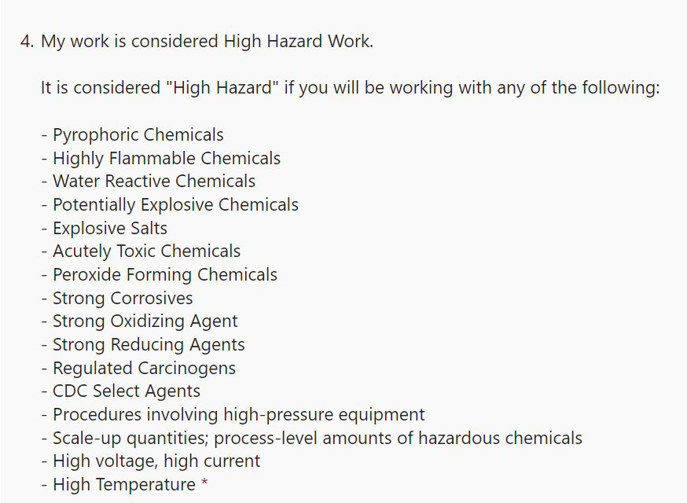
Working Alone Form
Any work completed on site between 5 PM & 8 AM, or over weekends
High risk work must be completed with a buddy
Both people must fill out the form
Form should be completed for each type of work done
Example: TC work, viral work, bacterial cultures, mini preps
Is your work considered high hazard work?
If you don’t know, come ask Alyssa and/or Sydni

Slide 22
Facility Overview
During an emergency, do not panic! Make your way out of the nearest exit to muster points.
Eye wash stations are at every sink, and shower/eye wash stations can be found throughout the lab (yellow circles).
If you need additional assistance, let any BioLabs staff member know!

Slide 23
Safety Specs Locations
There are several safety maps posted across the site with locations for the following
Safety showers and eyewash stations
Evacuation exits
Fire extinguishers, blankets, & alarms
AED
Hazardous chemical storage
Spill kits
Drains
The maps will have a star that indicate where you are

Slide 24
Thank You
3060 Pegasus Park Dr.
Dallas, TX 75247
www.biolabs.io

