Slide 1

New Bridge Labs Resident Onboarding
https://bridgelabsdallas.com

Slide 2
Onboarding Agenda
About BioLabs/Bridge Labs and Our Staff
Capital Connections
Virtual Platforms
Centralized and Group Purchasing
Shared Space Policies
Environmental Health and Safety (EH&S)
Facility Overview and Parking
www.biolabs.io © 2025 All rights reserved

Slide 3
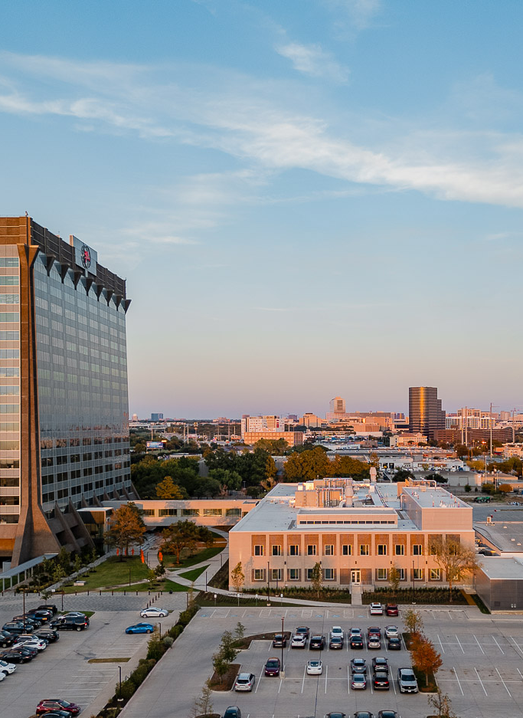
What is Bridge Labs?
Bridge Labs is a biotech hub that convenes North Texas’ ecosystem of companies, accelerators, investors, universities and talents. This facility is the first institutional-quality lab space in the region!
www.biolabs.io © 2025 All rights reserved

Slide 4




Meet Our Staff
Gabby Everett
BioLabs
Site Director
Texas A&M
PhD in Biochemistry
Alyssa Dubrow
BioLabs Associate Lab Manager
Texas A&M
B.S. in Biochemistry
Camille Shuey
BioLabs Lab Operations Associate
UT Arlington
B.S. in Biomedical Engineering
Kathryn Sheaffer
BioLabs Lab Operations Associate
Texas A&M
B.S. in Biology
www.biolabs.io © 2025 All rights reserved

Slide 5
New Resident Members
Staff must be notified of all new on-site members so they can be sent training & added to virtual platforms
4 parts:
  MediaLab video trainings
  Rules and Regulations
  Emergency contacts
  Parking Permit
www.biolabs.io © 2025 All rights reserved

Slide 6



Capital Connections
If you would like to get in touch with any of these companies, please email cshuey@biolabs.io and she can get you in touch with a representative.
www.biolabs.io © 2025 All rights reserved

Slide 7




Virtual Platforms
Package delivery: You will get an email notification that you have had a package delivered. Please pick it up at the dock and remember to sign it out!
Equipment and room reservation: Conveniently book shared equipment and rooms on the Coworks app!
BioLabs NTX website: Find this PowerPoint and additional information on our website!
www.biolabspegasuspark.com
Access code: 3060
www.biolabs.io © 2025 All rights reserved

Slide 8
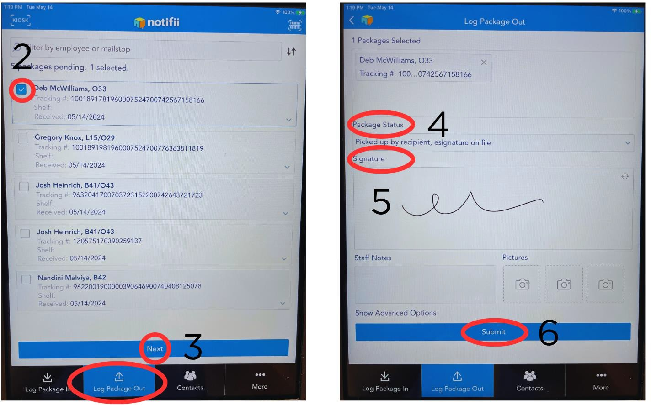
Notifii
www.biolabs.io © 2025 All rights reserved

Slide 9

Marketplace – Centralized Procurement System
BioLabs has their own purchasing and procurement system that is available to use if you would like to sign up- contact Alyssa or Gabby
Simplifies the order process
Allows users to track shipments
Special pricing available
Once a package arrives, it will be logged in at the dock.
If you would like to request a FedEx or UPS pickup, it can be done through Marketplace.
Dock address: 3020 Pegasus Park Dr. Dallas, TX 75247
Questions?
marketplace@biolabs.io
80%
Special Discounts
Average discounts of 35% off but have seen discounts up to 80% off at select vendors.
www.biolabs.io © 2025 All rights reserved

Slide 10
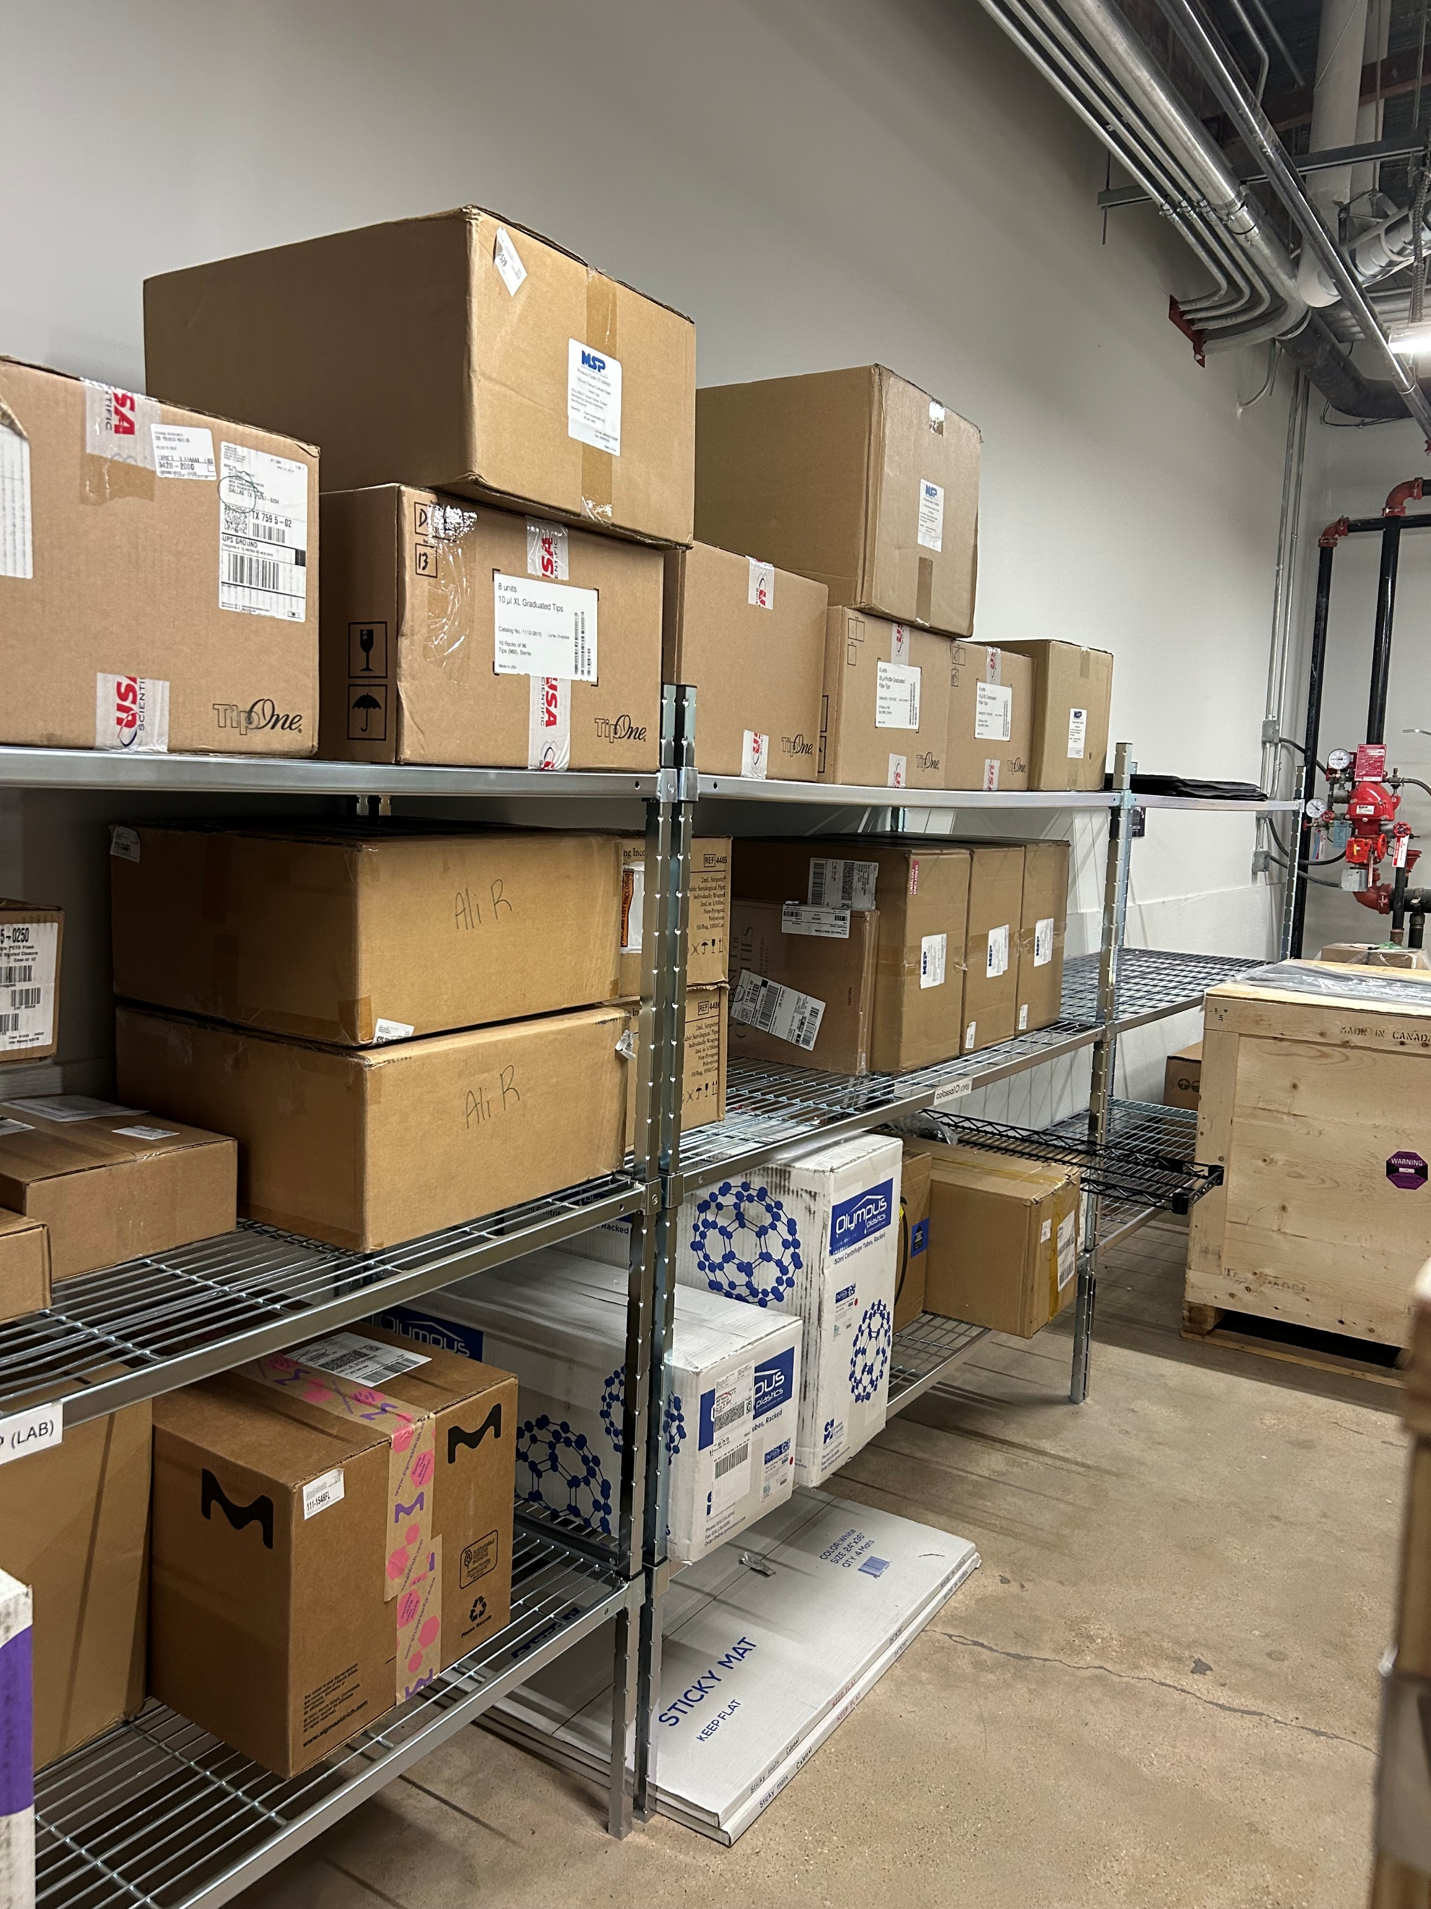
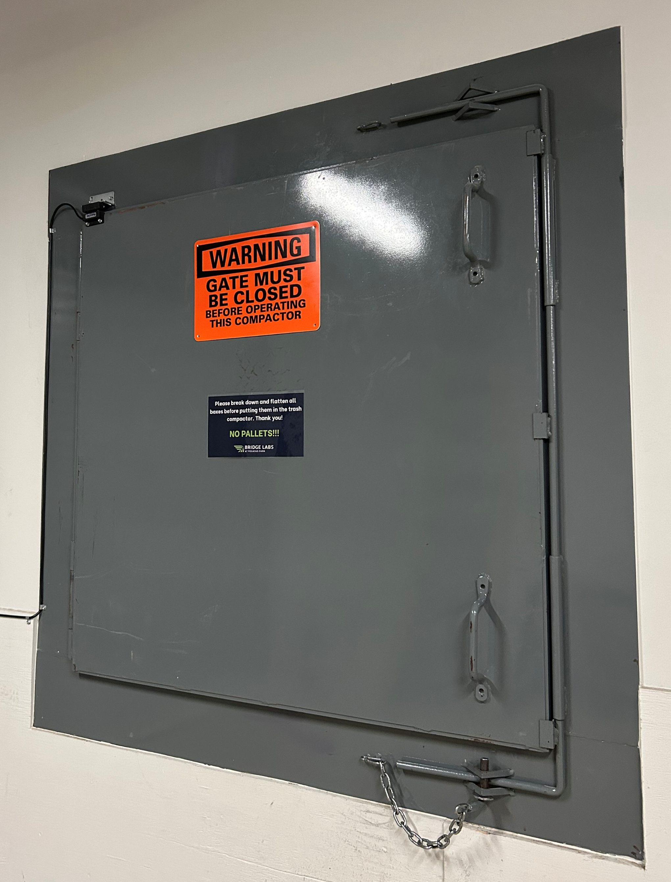
Loading Dock Policies
Packages/pallets:
Packages will be logged in by staff and put on the appropriate shelf. All shelves are labeled with the company/institution name
Pallets must be delivered inside the dock. Do not leave them on the loading docks
Do not leave empty pallets inside the loading dock- move to outside
Trash compactor:
Push trash down into the compactor
Close door before starting the compactor
Do not throw pallets into the compactor
www.biolabs.io © 2025 All rights reserved

Slide 11
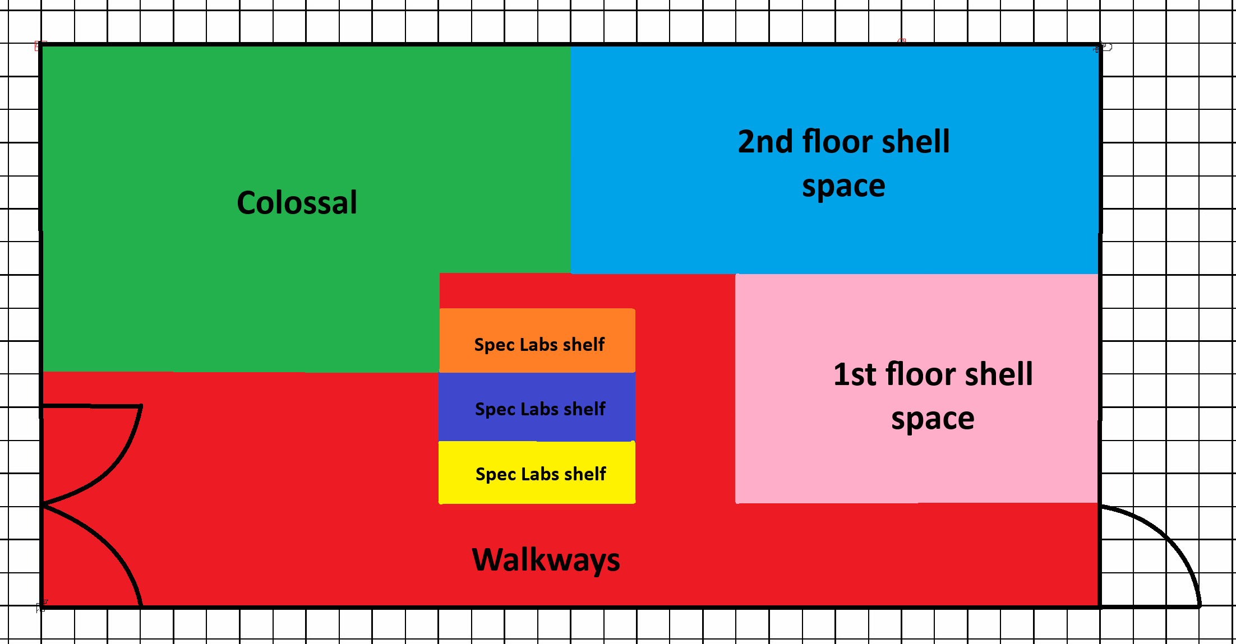
Shared General Storage Room Policies
Each tenant has been allocated storage space depending on their square footage. You are welcome to store boxes or put in shelving in your space. Do not store chemicals in this room!
www.biolabs.io © 2025 All rights reserved

Slide 12
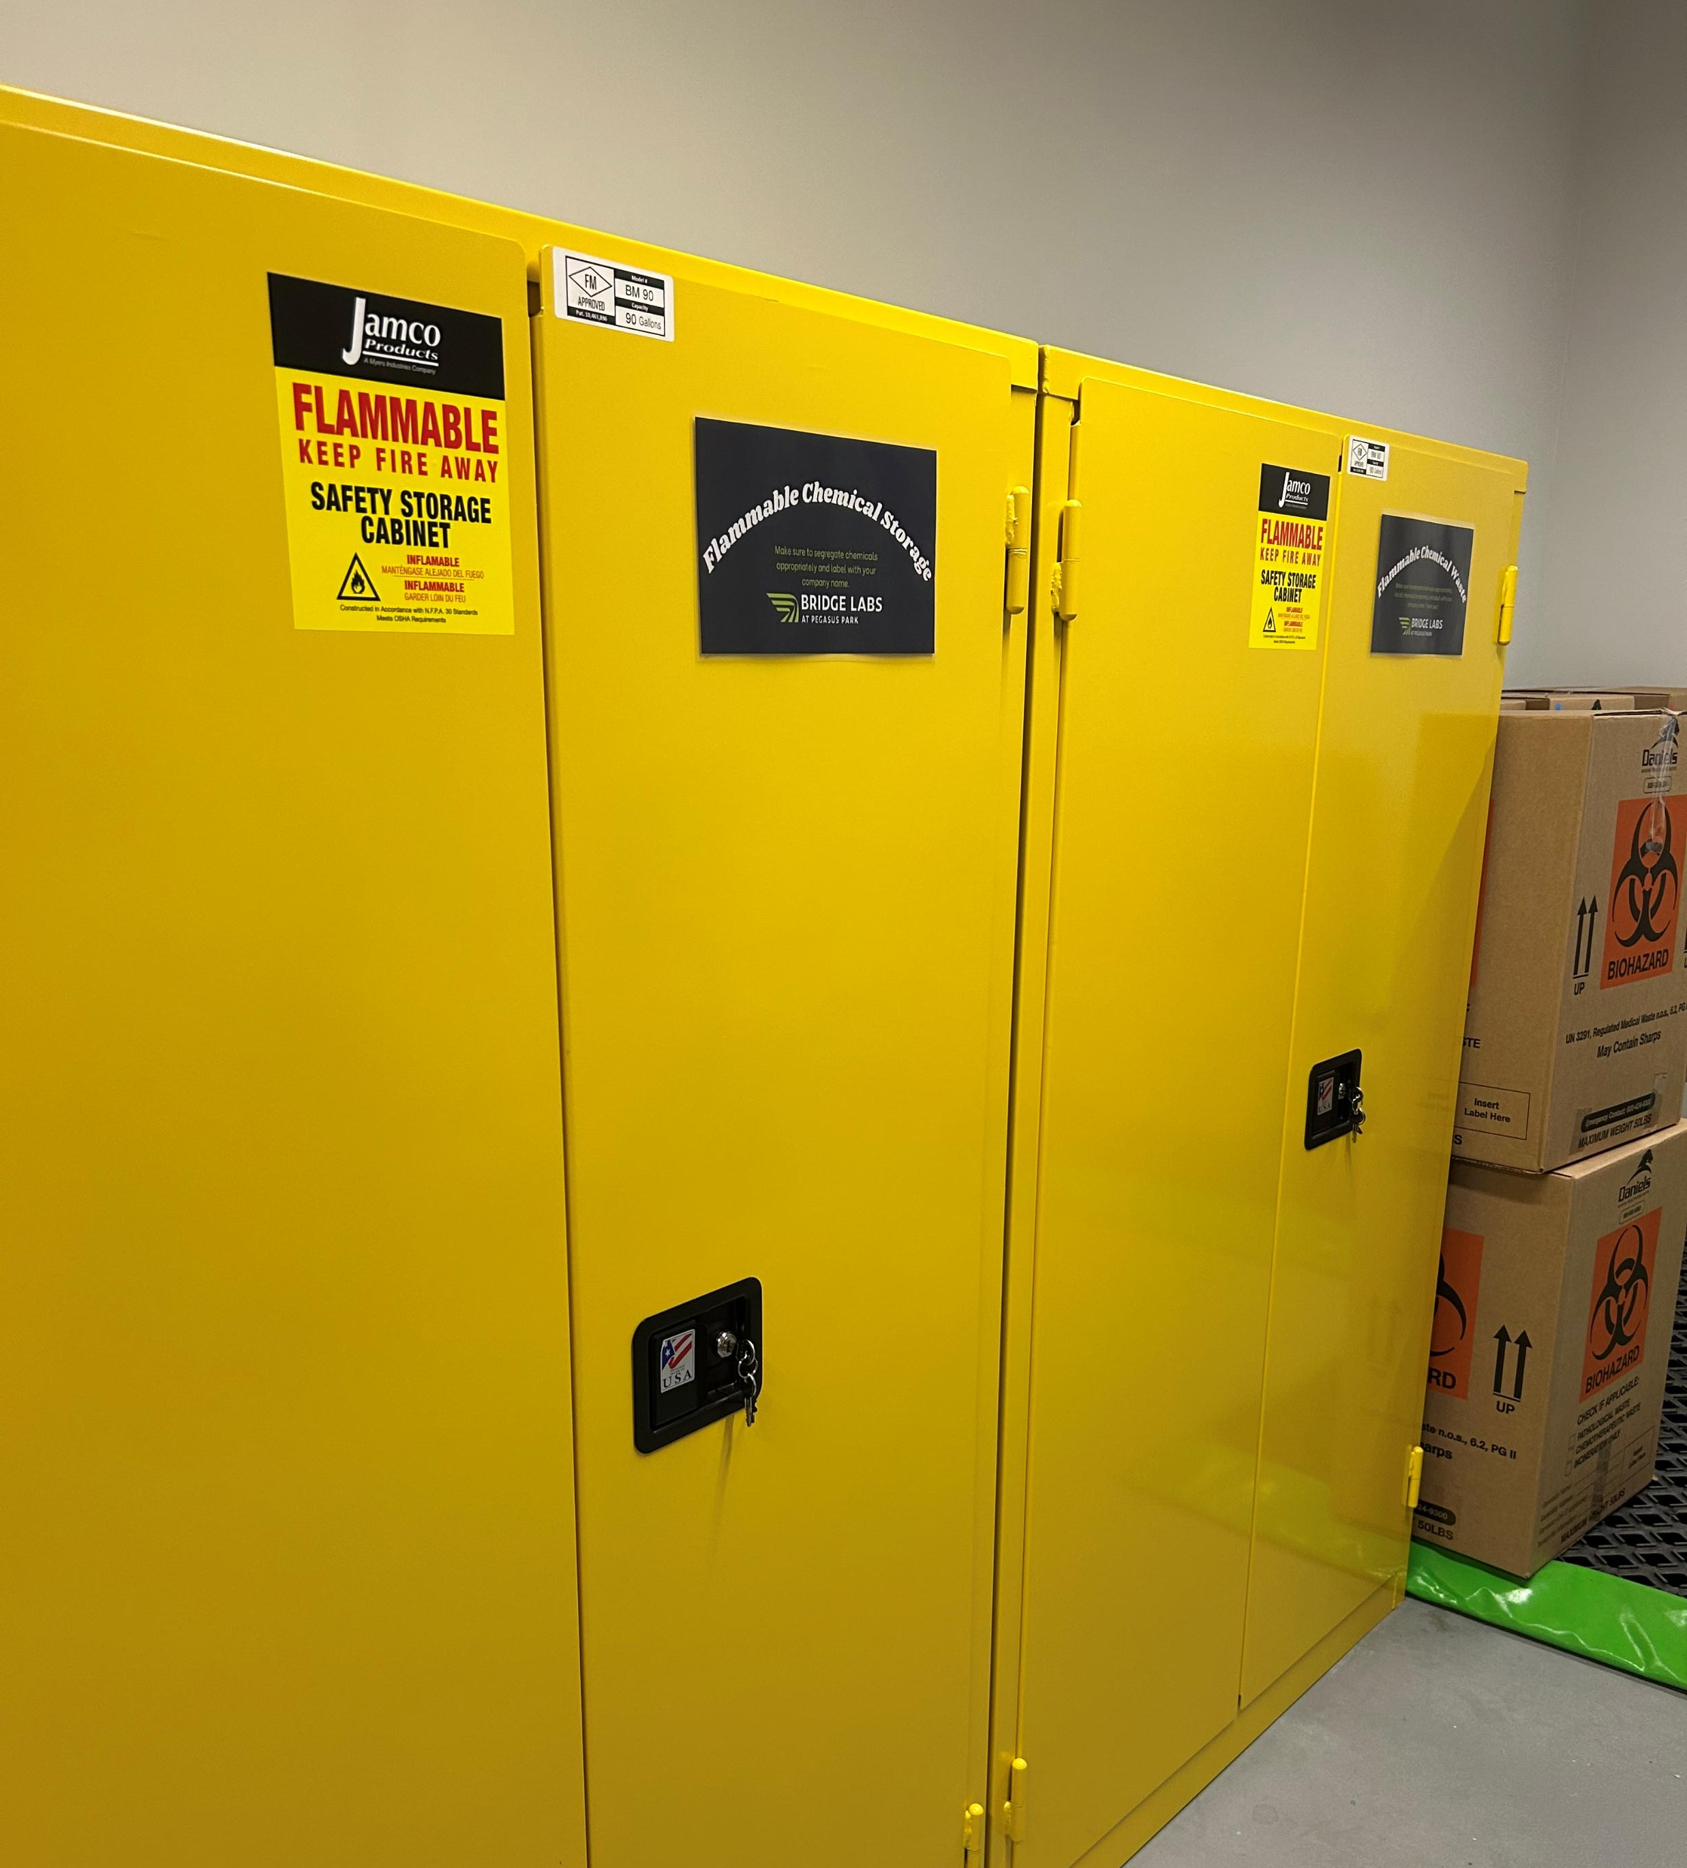
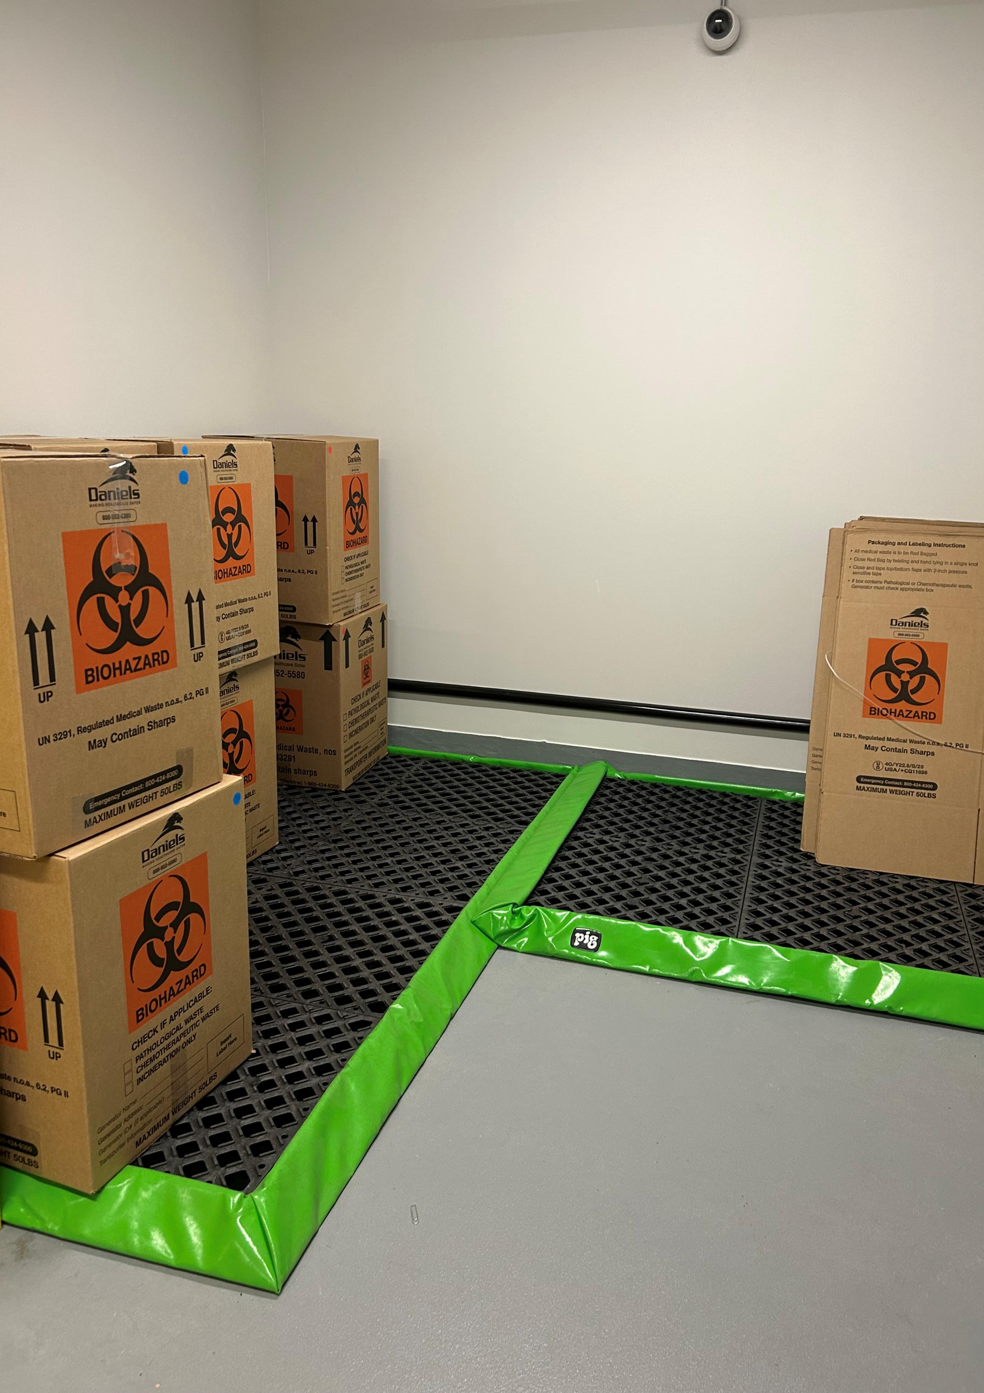
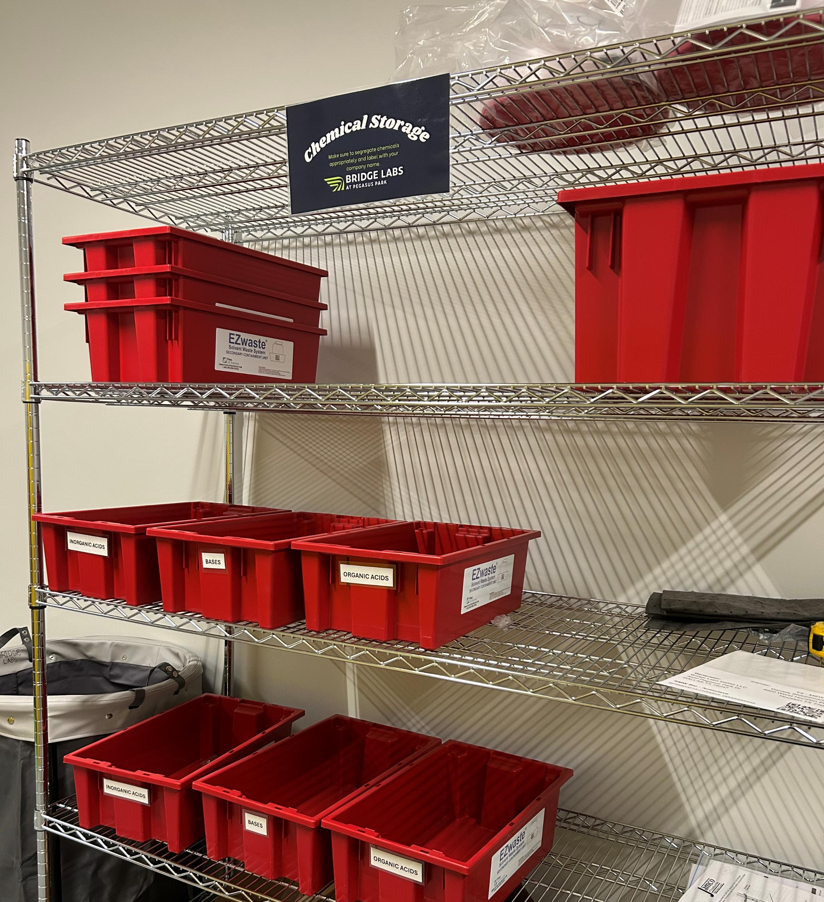
Shared Waste & Chemical Storage Room Policies- Waste
Segregate chemicals appropriately according to their SDS
Storage vs waste flammable cabinet & shelves
Double-bag solid biohazardous waste and package in the provided boxes for pickup
Label all chemicals and generated waste with provided stickers and company/institution name
Log all chemical and biohazardous waste in the appropriate binders
ALWAYS wear PPE in this room. Do not take PPE out of this room
NO PPE IN THE HALLS!
www.biolabs.io © 2025 All rights reserved

Slide 13
Shared Waste & Chemical Storage Room Policies- Storage
Chemical storage should be done in lab when possible
Store and segregate chemicals appropriately according to their SDS
Label all chemicals with provided stickers and company/institution name
  Ensure it is in the storage cabinet
Log all chemical and biohazardous waste in the appropriate binders
ALWAYS wear PPE in this room. Do not take PPE out of this room
NO PPE IN THE HALLS!
www.biolabs.io © 2025 All rights reserved

Slide 14
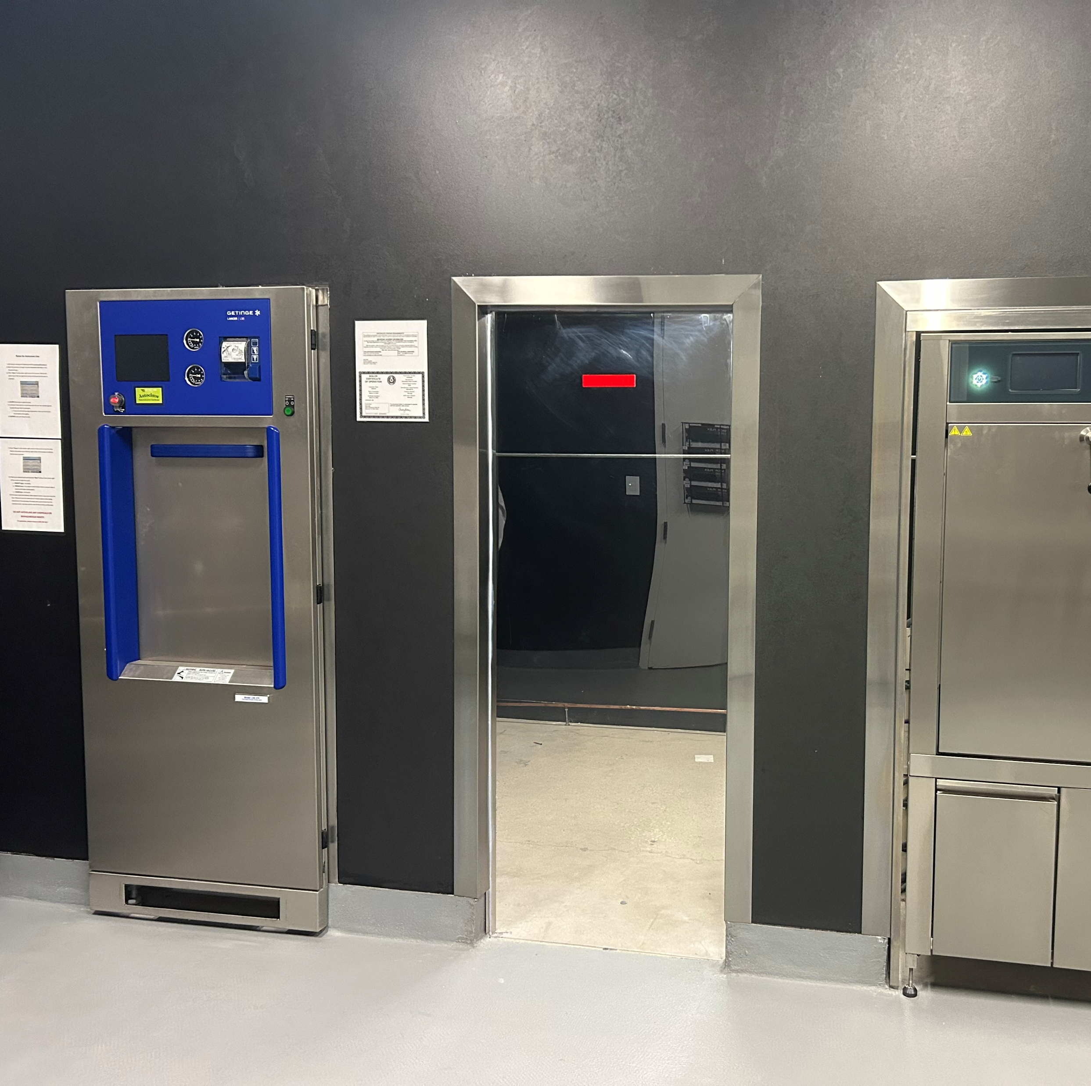
Shared Equipment Policies
Book shared equipment through Coworks
Do not leave items for long-term storage. Anything left for over 48hrs will be confiscated
Training by BioLabs staff is required before using this equipment. Please email adubrow@biolabs.io to schedule a training session
PPE is required in this room. Do not take PPE out of this room
www.biolabs.io © 2025 All rights reserved

Slide 15
Waste Generation
Types of Waste
Biohazardous Waste
Chemical Waste
Non-Hazardous Waste
If you have any uncertainties with chemical disposal, please reach out to BioLabs staff!
www.biolabs.io © 2025 All rights reserved

Slide 16


Non-Hazardous Waste
Can go down the drain or in the trash
Includes:
  Bleached biohazards
  Neutral buffers
  Uncontaminated media
If you have any uncertainties with chemical disposal, please reach out to BioLabs staff!
www.biolabs.io © 2025 All rights reserved

Slide 17

Liquid & Solid Biohazardous Waste
Solid Biohazardous Waste
Use a cart to transport boxed biohazardous waste into the waste room
Companies are responsible for purchasing their own biohazard bins
Residents CANNOT autoclave biohazardous waste. Biohazardous waste is sent out for incineration.
Liquid Biohazardous Waste
Add enough bleach to create a 10% solution
Let it sit for 15 min-30 min
Disinfected contents can be poured down the sink. Flush with water for at least 5 min
If you have any uncertainties with chemical disposal, please reach out to BioLabs staff!
www.biolabs.io © 2025 All rights reserved

Slide 18
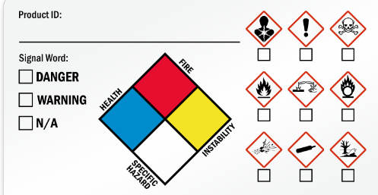
Hazardous Chemical Waste
Anything labeled “Warning”, “Danger”, etc. on the SDS
  Have a plan for safe use, storage, and disposal.
You MUST notify BioLabs staff of any chemical waste being produced
  Typically stored in compatible container for liquid, Ziploc bag for solids. Separate solid and liquid chemical waste
  Label all chemical waste with chemical compounds, full name, and company name
  Log all chemical waste in the Chemical Waste Log binder
Do NOT combine chemicals!
Do NOT pour chemicals down the drain (including ethanol)!
If you have any uncertainties with chemical disposal, please reach out to BioLabs staff!
www.biolabs.io © 2025 All rights reserved

Slide 19

Hazardous Chemical Waste Cont.
Do NOT dispose of chemical in autoclave bags!
  These bags get sent out for incineration and can generate harmful fumes
If your waste contains both chemical and biohazardous waste, it defaults to chemical
  Ex: Cells with PFA will default to chemical waste
If you have any uncertainties with chemical disposal, please reach out to BioLabs staff!
www.biolabs.io © 2025 All rights reserved

Slide 20
Safety Officers
Each company/institution has been appointed a safety officer.
  Role: inform and enforce EH&S policies within their company.
  They will attend periodic meetings with BioLabs staff to give updates on any changes to workflow or new hazardous waste generation.
UDX | Sydni H.
Colossal | Josh H.
NCTM | Logan A.
Stealth Co. | Nick R.
www.biolabs.io © 2025 All rights reserved

Slide 21
Site-Wide SDS Repository
All on-site chemical SDS’s can be found here: Bridge Labs Site-Wide SDS Repository
Contact your appointed safety officer for company/institution-specific SDS’s
www.biolabs.io © 2025 All rights reserved

Slide 22
Chemical Inventory Sheets
ALL chemicals, hazardous or not, must be updated on a chemical inventory sheet
BioLabs staff will collect these sheets twice yearly
Requirements:
  Chemical Name
  Manufacturer
  Vendor
  Catalogue #
  Date Received
  CAS # (if applicable)
  Peroxide former Y/N (list expiration date/date opened if yes)
www.biolabs.io © 2025 All rights reserved

Slide 23
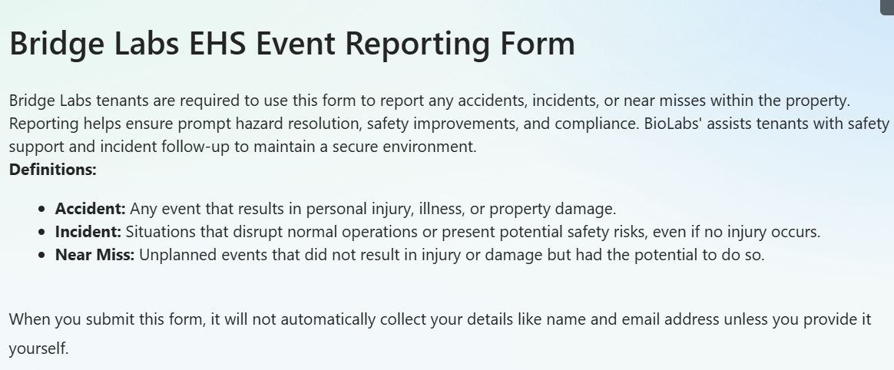
EH&S Event Reporting
BioLabs staff must be notified of any EHS events
BioLabs staff will conduct monthly EHS audits- Alyssa will contact to schedule
Find the Bridge Labs EH&S Event Reporting Form on our website under the Bridge Labs tab:
www.biolabspegasuspark.com
Access code: 3060
www.biolabs.io © 2025 All rights reserved

Slide 24
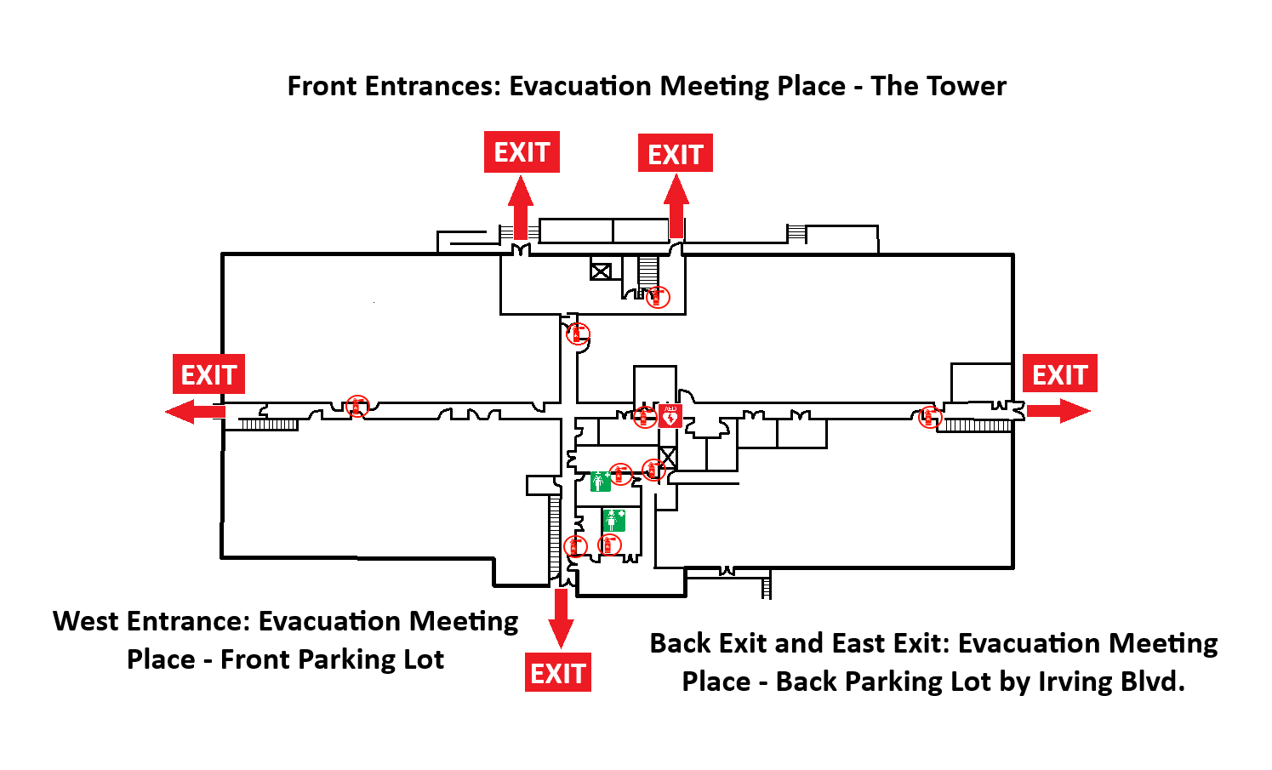
Facility Overview
www.biolabs.io © 2025 All rights reserved

Slide 25
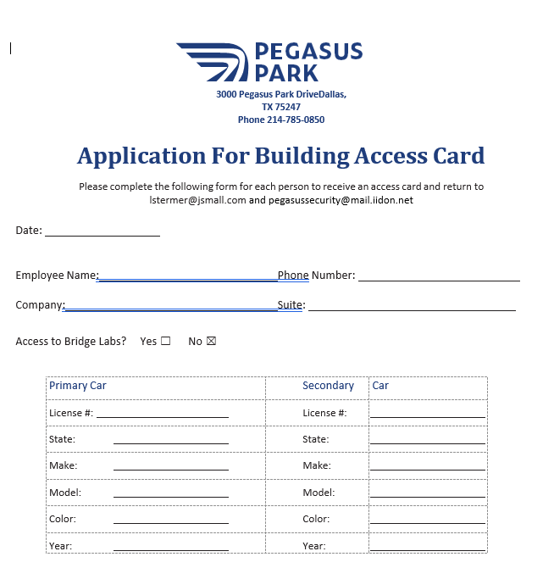
Campus Access
Please email filled out form to lstermer@jsmall.com and pegasussecurity@mail.iidon.net for after-hours campus access and Bridge Labs access.
www.biolabs.io © 2025 All rights reserved

Slide 26

STRANGER DANGER
Security starts with YOU!
  Do not let people in you don’t know
Remember your badges!
Security concerns?
  24/7 campus security number: (972) 595-8493
www.biolabs.io © 2025 All rights reserved

Slide 27
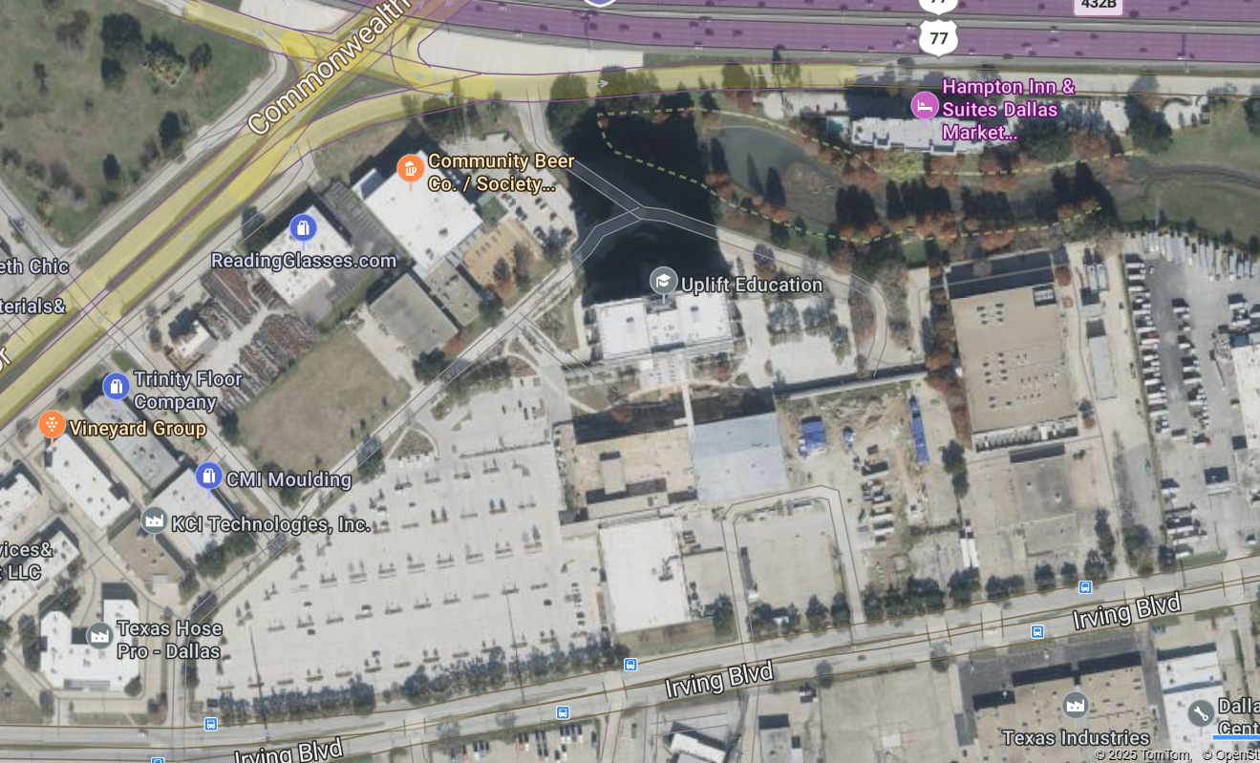
Parking Overview
Front Parking Lot Address: 3020 Pegasus Park Dr.
Back Parking Lot Address: 3033 Irving Blvd.
You need your badge!
Pegasus Park Dr.
The Tower
Bridge Labs
BioLabs
Back Parking Lots
Front Parking Lot
www.biolabs.io © 2025 All rights reserved

Slide 28
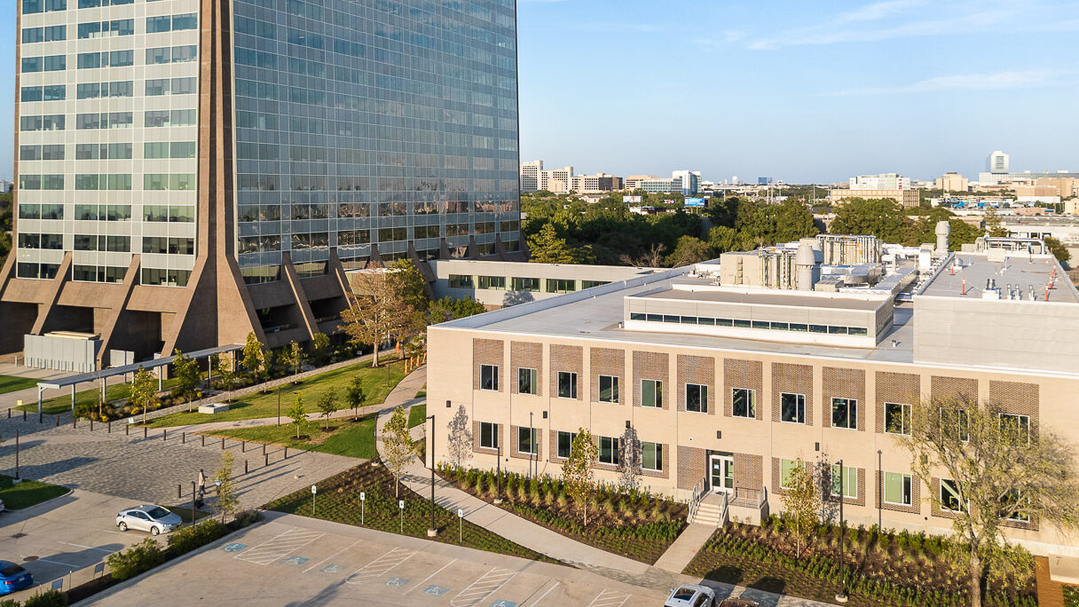


Thank You ☺
3020 Pegasus Park Dr.
Dallas, TX 75247
https://bridgelabsdallas.com

